Slide 1
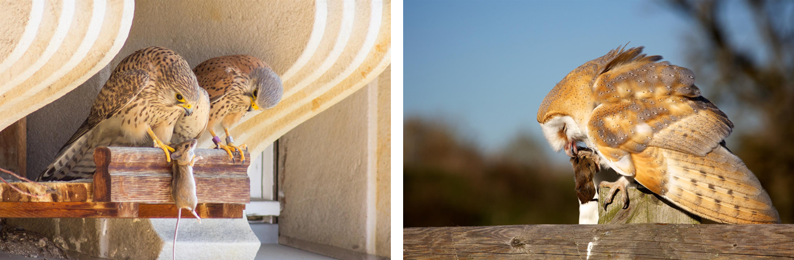
Exposure of wildlife to rodenticides
CRRU UK
A training resource for:
Continuing Professional Development
© Copyright 2026
This presentation may be used free of charge in any format or medium provided that it is reproduced accurately and not used
in a misleading context. The material must be acknowledged as CRRU UK copyright and the title of the document specified.
Notes:
Image left: Kestrels Falco tinnunculus with small non-target rodent, Apodemus sp
Image right: Barn Owl Tyto alba with small non-target rodent
Title Slide
This module contains some information that will be new to the participants. It may be necessary to progress at a somewhat slower pace and to recap some of the more difficult sections.
When they have completed this module the participants will be expected to possess the following essential knowledge and skills to:
describe the main anticoagulants used in the UK and the restrictions placed on their use
understand the reasons why rodenticide use in rural areas is important in terms of contamination of wildlife
understand the two main unwanted impacts of exposure of wildlife to vertebrate control agents
understand the objectives and operation of WIIS
understand the different causes and consequences of WIIS incidents
understand the extent of low-level residues of anticoagulants in wildlife, including data provided by the PBMS and other studies
understand the pathways by which different wildlife species are exposed to rodenticides
interpret the findings of the relevant studies in terms of impacts on wildlife populations

Slide 2
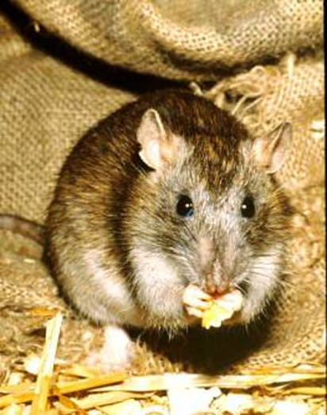
First and second-generation rodenticides
First-generation compounds include coumatetralyl (FGARS)
Second-generation compounds (SGARs) were introduced because of resistance to FGARs
All SGARs are more acutely toxic and persistent in the environment
None has been reliably shown to be more persistent in the environment than any other
© WWF/IUCN International Education Project
© Copyright 2026
This presentation may be used free of charge in any format or medium provided that it is reproduced accurately and not used
in a misleading context. The material must be acknowledged as CRRU UK copyright and the title of the document specified.
Notes:
TAKE HOME MESSAGE – SGARs PRESENT GREATER RISK TO NON-TARGET ANIMALS THAN FGARs.
Anticoagulant rodenticides are the most widely used active substances for rodent control, both in the UK and throughout the world. They have been in the market since the early 1950s and have an outstanding record for safety and effectiveness.
Resistance to the first-generation of anticoagulants was first seen in Norway rats in the late 1960’s. Therefore, a second generation of compounds was invented and brought to the market. These were capable of controlling infestations that were resistant to the earlier compounds. However, in order to achieve this they were necessarily both more acutely toxic and more persistent in animal tissues.
There is a widely-held misconception that some SGARs (e.g. brodifacoum and flocoumafen) are more persistent than others. This is not so. When compared in properly controlled comparative experiments, all SGARs have long biological half-lives in animal tissues.
For more information on these materials see:
Buckle, A. P. and C. T. Eason (2015). Rodent control methods: chemical. Rodent Pests and their Control. 2nd Edition. A. P. Buckle and R. H. Smith editors. Wallingford, Oxon, UK, CAB International. pp 123-154.
World Health Organization ( 1995). Anticoagulant Rodenticides. Environmental Health Criteria 175. International Programme on Chemical Safety. Mode of action and metabolism. Pp 44-52.

Slide 3
Rodenticide use in UK rural areas
Historic data shows rodenticide used on 80-90% of farms growing grass, arable or fodder crops
Large use of SGARs by farmers, gamekeepers and professional pest controllers
Difenacoum and bromadiolone most widely used
No recent figures on quantities used, apart from in Scotland
Data from before introduction of difethialone and when brodifacoum and flocoumafen were restricted to use indoors
Historical data from Pesticide Usage Survey Report 175, Central Science Laboratory (now Animal and Plant Health Agency)
© Copyright 2026
This presentation may be used free of charge in any format or medium provided that it is reproduced accurately and not used
in a misleading context. The material must be acknowledged as CRRU UK copyright and the title of the document specified.
Notes:
TAKE HOME MESSAGE – RODENTICIDES ARE WIDELY USED IN RURAL AREAS, MOST COMMONLY THE ACTIVE SUBSTANCES DIFENACOUM AND BROMADIOLONE
Second-generation anticoagulants are the most widely used rodenticide active substances. Among these, difenacoum and bromadiolone are the most commonly used. The historical restriction on the use of brodifacoum and flocoumafen to use ‘only indoors’ meant in the past that they were largely inappropriate for use against rat infestations in rural areas, hence their limited overall use, which is shown in this graph.
Defra keeps records of the quantities of the different rodenticide active substances used in the UK and these data are available on-line at:
https://pusstats.fera.co.uk/home
Unfortunately, these rodenticide usage surveys were stopped in England and Wales many years ago. Therefore we have no up-to-date information about the amounts of the different SGAR active substances that are used in these countries of the UK. However, it remains highly likely that the active substances difenacoum and bromadiolone remain the compounds used predominantly.
On the contrary, these surveys have continued in Scotland and these confirm the continued predominant use of bromadiolone and difenacoum.
The data produced in Scotland by Science and Advice for Scottish Agriculture can be found here: https://www.sasa.gov.uk/search/content/rodenticides

Slide 4
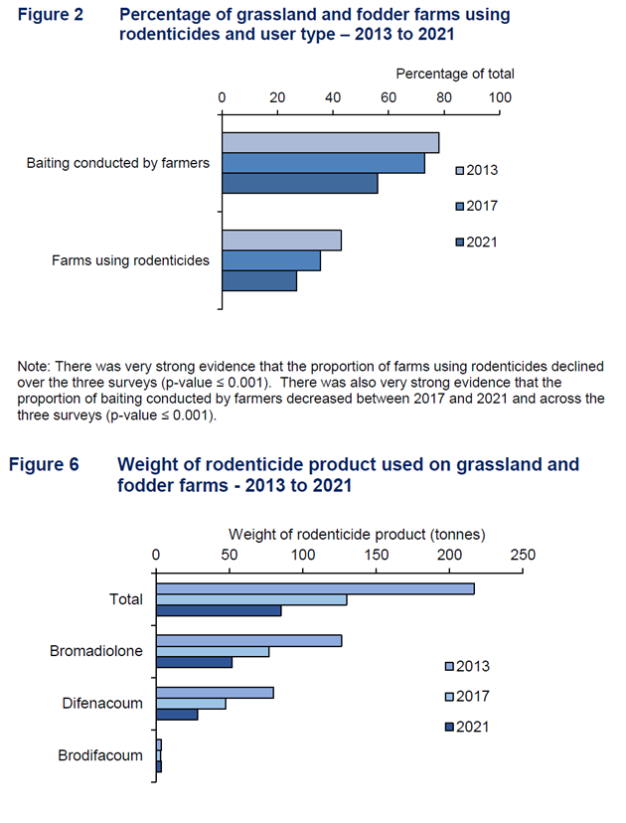
Rodenticide use in Scotland – grassland & fodder farms (SASA)
Rodenticide used on 27% of grassland and fodder farms in 2021 – a decline
A decline in baiting conducted by farmers, with professional pest controllers being utilised
Difenacoum and bromadiolone most widely used, although rodenticide totals are declining – 61% down from 2013
Low levels of brodifacoum applied
© Copyright 2026
This presentation may be used free of charge in any format or medium provided that it is reproduced accurately and not used
in a misleading context. The material must be acknowledged as CRRU UK copyright and the title of the document specified.
Notes:
TAKE HOME MESSAGE – RODENTICIDES ARE WIDELY USED IN RURAL AREAS, MOST COMMONLY THE ACTIVE SUBSTANCES DIFENACOUM AND BROMADIOLONE
Second-generation anticoagulants are the most widely used rodenticide active substances. Among these, difenacoum and bromadiolone are the most commonly used. The historical restriction on the use of brodifacoum and flocoumafen to use ‘only indoors’ meant in the past that they were largely inappropriate for use against rat infestations in rural areas, hence their limited overall use, which is shown in this graph.
Defra keeps records of the quantities of the different rodenticide active substances used in the UK and these data are available on-line at:
https://secure.fera.defra.gov.uk/pusstats/surveys/index.cfm
Unfortunately, these rodenticide usage surveys were stopped in England and Wales many years ago. Therefore we have no up-to-date information about the amounts of the different SGAR active substances that are used in these countries of the UK. However, it remains highly likely that the active substances difenacoum and bromadiolone remain the compounds used predominantly.
On the contrary, these surveys have continued in Scotland and these confirm the continued predominant use of bromadiolone and difenacoum.
The data produced in Scotland by Science and Advice for Scottish Agriculture can be found here: https://www.sasa.gov.uk/search/content/rodenticides

Slide 5
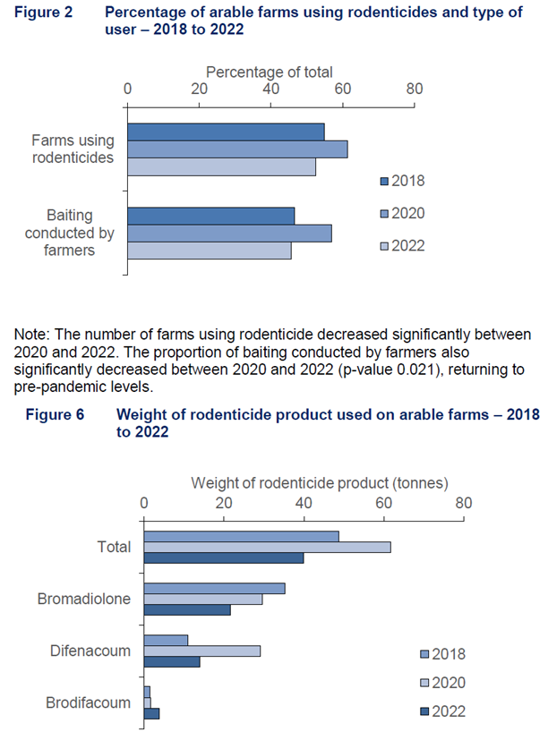
Rodenticide use in Scotland – arable farms (SASA)
Rodenticide used on 52% of arable farms in 2022 – a decline
A decline in bating conducted by farmers, with professional pest controllers being utilised
Difenacoum and bromadiolone most widely used, although rodenticide totals are declining – 35% down from 2020
Low levels of brodifacoum applied, with an increase in 2022
© Copyright 2026
This presentation may be used free of charge in any format or medium provided that it is reproduced accurately and not used
in a misleading context. The material must be acknowledged as CRRU UK copyright and the title of the document specified.

Slide 6
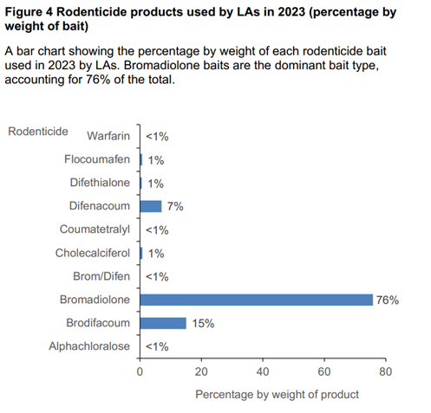
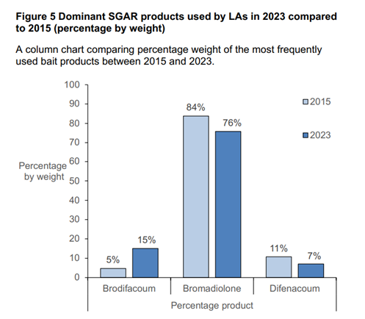
Rodenticide use in Scotland – Local Authorities (SASA)
LAs used 12.2 tonnes of rodenticide bait in 2023, down from 14.9 tonnes in 2015
Bromadiolone the dominant rodenticide used
Decrease in bromadiolone and difenacoum
Increase in brodifacoum use
© Copyright 2026
This presentation may be used free of charge in any format or medium provided that it is reproduced accurately and not used
in a misleading context. The material must be acknowledged as CRRU UK copyright and the title of the document specified.
Notes:
https://www.gov.scot/binaries/content/documents/govscot/publications/statistics/2025/03/pesticide-usage-scotland-rodenticide-use-local-authorities-2023/documents/rodenticide-use-local-authorities-2023/rodenticide-use-local-authorities-2023/govscot%3Adocument/rodenticide-use-local-authorities-2023.pdf

Slide 7
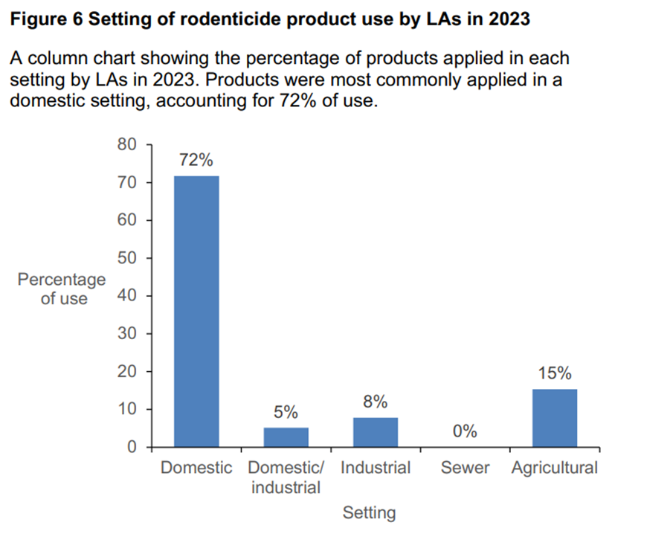
Rodenticide use in Scotland – Local Authorities (SASA)
Most LA use is in domestic settings – less likely to result in wildlife contamination
© Copyright 2026
This presentation may be used free of charge in any format or medium provided that it is reproduced accurately and not used
in a misleading context. The material must be acknowledged as CRRU UK copyright and the title of the document specified.
Notes:
The data produced in Scotland by Science and Advice for Scottish Agriculture can be found here: https://www.sasa.gov.uk/search/content/rodenticides
https://www.gov.scot/binaries/content/documents/govscot/publications/statistics/2025/03/pesticide-usage-scotland-rodenticide-use-local-authorities-2023/documents/rodenticide-use-local-authorities-2023/rodenticide-use-local-authorities-2023/govscot%3Adocument/rodenticide-use-local-authorities-2023.pdf

Slide 8
Use Scenarios (1)
‘Indoors’ – all rodenticide baits
Situations where the bait is placed within a building or other enclosed structure and where the target is living or feeding predominantly within that building or structure; and behind closed doors. If rodents living outside a building can move freely to where the bait is laid within the building, then products restricted to use indoors should NOT be used. Open barns or buildings and tamper-resistant bait stations placed in open areas are not classified as indoors.
Low risk of exposure to non-targets
© Copyright 2026
This presentation may be used free of charge in any format or medium provided that it is reproduced accurately and not used
in a misleading context. The material must be acknowledged as CRRU UK copyright and the title of the document specified.
Notes:
TAKE HOME MESSAGE – INDOOR USES OF RODENTICIDES POSE LITTLE RISK TO NON-TARGET WILDLIFE IF THE DEFINITION OF THIS USE IS STRICTLY APPLIED. BUT SUCH DEFINITION RULES OUT ALMOST ALL TREATMENTS FOR RATS.
This is the rodenticide use pattern that results in the least risk of environmental exposure to non-target animals, provided the definition is strictly applied. That is that animals having access to baits supposedly deployed only indoors do not move outdoors having consumed bait and, conversely, animals living outside do not have access to the indoor baits.
These conditions are most easily met when baiting is conducted for house mice using mouse tamper-resistant bait stations. Virtually all house mouse infestations are ‘living and feeding predominantly’ indoors.
It is extremely rare that a use scenario involving baiting for Norway rats can satisfy these provisions, however, because most rat infestations have some individuals, often the majority, living and feeding outside buildings.
In principle, all anticoagulant active substances are permitted for use indoors only in the UK. But care must be taken and the labels of individual authorised rodenticide products must be read carefully to ensure that such use is permitted by the authorisation.

Slide 9
Use Scenarios (2)
‘In and around buildings’
‘In and around buildings’ is understood to include the entire building that is the subject of the treatment, or those areas of it that are or may become infested. It also includes the infested area around the building that needs to be treated in order to deal with the rodents that are potentially moving into the building, causing damage to the building or property, or present a risk to the health of people or other animals.
Moderate risk of exposure to non-targets in semi-urban and rural environments
© Copyright 2026
This presentation may be used free of charge in any format or medium provided that it is reproduced accurately and not used
in a misleading context. The material must be acknowledged as CRRU UK copyright and the title of the document specified.
Notes:
TAKE HOME MESSAGE - THIS IS THE MOST COMMONLY USED SCENARIO FOR RODENTICIDE APPLICATIONS AND IS APPROPRIATE FOR USE AGAINST BOTH RATS AND MICE
This is by far the most common use scenario when baiting is conducted against Norway rat infestations because the animals are usually living outdoors but may be entering buildings to feed.
In all semi-urban and rural situations when baits placed outdoors for rats, whether placed in tamper-resistant baits stations or not, they are accessible to a wide range of non-target species, including wild small mammals, birds, molluscs and insects. These form the prey base of a large number of predatory mammal and bird species. It is via this route that many of our non-target species are exposed to rodenticides.
Therefore, environmental risk is present. However, this risk is directly proportionate to the number and variety of non-target species present in the vicinity of the bait. For example, in many fully urban scenarios there may be very few larger non-target animal species present and the risk will therefore be small. In contrast, in rural situations, for example in and around farmsteads, non-target mammals and birds may be abundant and the risk of non-target exposure and environmental contamination may be considerable.
In principle, all anticoagulant active substances are permitted for application in and around buildings in the UK. But care must be taken and the labels of individual authorised rodenticide products must be read carefully to ensure that such use is permitted by the authorisation.

Slide 10
Use Scenarios (3)
‘Open areas’ – there is a cholecalciferol option
European Commission documents describe uses “around farmland, parks and golf courses” as typical of open area applications. The term is also used when “rodenticides are used to reduce impacts on game rearing or outside (i.e. in field) food stores (potato/sugar beet clamps)”. An open area is therefore one that fits neither of the two preceding definitions and is an urban, suburban or rural space that is not directly associated with a building.
High risk of exposure to non-target wildlife
© Copyright 2026
This presentation may be used free of charge in any format or medium provided that it is reproduced accurately and not used
in a misleading context. The material must be acknowledged as CRRU UK copyright and the title of the document specified.
Notes:
TAKE HOME MESSAGE:- THE OPEN AREA USE SCENARIO CARRIES THE GREATEST RISK OF EXPOSURE TO NON-TARGET WILDLIFE
Rodenticide applications in ‘open areas’ are usually those which are made to combat infestations, normally of Norway rats, that are not directly associated with a building or other man-made structure.
Depending on their exact locations, these applications are likely to pose the greatest risk of non-target exposure because it is in open areas that non-target species are likely to be present most frequently.
No second generation anticoagulant active substances are permitted for application in open areas in the UK.

Slide 11
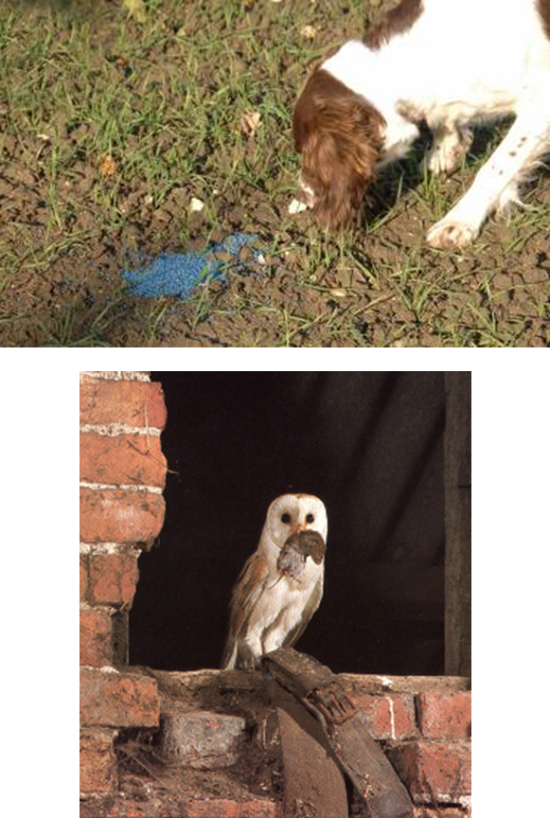
Exposure of Animals –
Two main routes of exposure
Primary poisoning
Non-target animal consumes bait directly
Secondary poisoning
Non-target consumes another animal (either target or non-target) which has itself consumed bait
© Copyright 2026
This presentation may be used free of charge in any format or medium provided that it is reproduced accurately and not used
in a misleading context. The material must be acknowledged as CRRU UK copyright and the title of the document specified.
Notes:
TAKE HOME MESSAGE – THESE TWO EXPOSURE PATHWAYS ARE THE MOST IMPORTANT WAYS BY WHICH NON-TARGETS ARE EXPOSED
The terms primary and secondary poisoning are used frequently in this module. Use this slide if you think participants need to have these explained to them.

Slide 12
Tertiary poisoning?
Some birds of prey that are specialist feeders on other birds (sparrowhawk and peregrine) are also contaminated
Contamination may be from consuming rodents occasionally
But main prey is other birds
Songbirds, such as thrushes, blackbirds, feed on insects and molluscs that enter bait boxes and consume bait
Some predatory birds may be exposed to rodenticides via this tertiary route
© Copyright 2026
This presentation may be used free of charge in any format or medium provided that it is reproduced accurately and not used
in a misleading context. The material must be acknowledged as CRRU UK copyright and the title of the document specified.
Notes:
TAKE HOME MESSAGE – WE THINK THAT SOME SPECIES ARE EXPOSED WHEN THEY CONSUME NON-TARGETS, SUCH AS SMALL BIRDS, THAT HAVE EATEN INVERTEBRATES THAT HAVE TAKEN BAIT FROM BAIT STATIONS
Quite recently, and somewhat surprisingly, it became apparent that some non-target species that feed predominantly on birds, such sparrowhawk and peregrine, are contaminated with anticoagulants. It may be that this is happening via several different pathways. Sparrowhawks feed mainly on small passerine birds, such as thrushes, blackbirds, finches, and tits. Some of these birds may feed on rodenticide baits directly, either by entering bait stations or by taking baits that have spilled from them – classic secondary poisoning. However, many of the sparrowhawk’s prey also feed on molluscs and insects. These are often found in bait stations feeding on baits. Therefore, the sparrowhawks are exposed to anticoagulants via two previous stages in the pathway (molluscs/insects and small passerines) – hence tertiary exposure.
Peregrines feed on larger prey species and in the UK feral pigeons are very common prey items. These may be exposed to anticoagulants when they take bait from poorly covered bait points or that spilled from bait stations.
or more on the food of these two species see: Cramp, S. (1980) (Chief Editor). Handbook of the birds of Europe, the Middle East and North Africa, Volume II – Hawks to Bustards. Sparrowhawk pp158-168, peregrine pp 361-378.
More on residues see: Walker, L.A., Chaplow, J.S., Moeckel C., Pereira M.G., Potter, E.D. & Shore, R.F.(2015). Anticoagulant rodenticides in sparrowhawks: a Predatory Bird Monitoring Scheme (PBMS) report. Centre for Ecology & Hydrology, Lancaster, UK.12 pp. And Hughes J, Sharp E, Taylor MJ, Melton L, Hartley G (2013) Monitoring agricultural rodenticide use and secondary exposure of raptors in Scotland. Ecotoxicology 22, 974-984.

Slide 13
Two concerns about rodenticides use
Incidents of lethal exposure of wildlife to vertebrate pest control pesticides – either criminal or accidental
Monitored by Wildlife Incident Investigation Scheme (WIIS)
Addressed by PAW (Partnership for Action Against Wildlife Crime)
Widespread low-level, non-lethal residues of anticoagulants – either accidental or by misuse/abuse of rodenticides
Monitored by Predatory Birds Monitoring Scheme (PBMS) and other independent studies
Addressed by Campaign for Responsible Rodenticide Use (CRRU) via the UK Rodenticide Stewardship Regime
© Copyright 2026
This presentation may be used free of charge in any format or medium provided that it is reproduced accurately and not used
in a misleading context. The material must be acknowledged as CRRU UK copyright and the title of the document specified.
Notes:
TAKE HOME MESSAGE – WE ARE CONCERNED ABOUT BOTH DIRECT MORTALITY CAUSED BY EXPSOURE TO RODENTICIDES AND BY WIDESPREAD, LOW-LEVEL EXPOSURE THAT DOES NOT IMMEDIATELY CAUSE DEATH
There are two important concerns about the use of rodenticides in the UK.
Occasionally, incidents are reported in which the deaths of domestic animals and wildlife are suspected to have been caused by rodenticides. These incidents are investigated and reported within a system called the Wildlife Incident Investigation Scheme (WIIS). See: https://www.hse.gov.uk/pesticides/reducing-environmental-impact/wildlife-incident-investigation-scheme.htm
The scheme is operated by different government departments in England (Chemicals Regulation Directorate), Wales (Welsh Government), Scotland (Science and Advice for Scottish Agriculture and Norther Ireland (Department of Agriculture and Rural Development)
In relation to the quantities of pesticides used, these incidents may be considered to be relatively infrequent. But of course there is concern that we do not know what proportion of incidents that actually occur are reported and investigated.
The second concern is that, increasingly, very low levels of residues of anticoagulants are found in a variety of wildlife species. There is no compelling evidence that these residues cause harm either to individuals or populations. But, by their presence, they indicate a widespread exposure of wildlife to these compounds that we must attempt to prevent. Of course, these two issues are not entirely separate. It is possible that, by repeated exposure, low and initially insignificant residues may build up to reach levels that are potentially damaging to the individual animals that carry them.
The combination of these two areas of concern has caused UK government to require the development and implementation of the UK Rodenticide Stewardship Regime, which is co-ordinated and monitored by CRRU UK

Slide 14
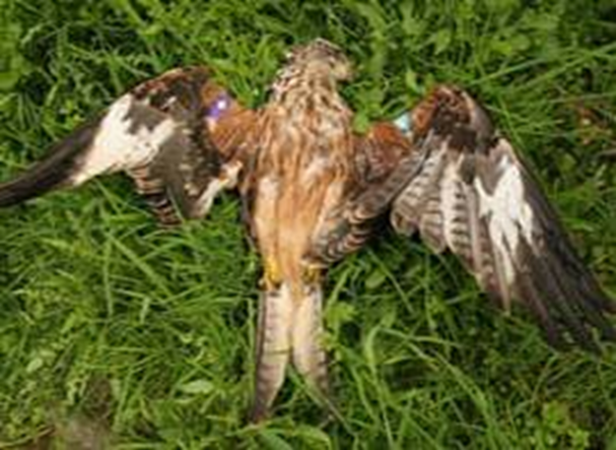
Concern 1. Lethal exposure of wildlife, pets and farm stock
Affect a wide range of wildlife species – some of considerable conservation importance e.g. red kites, barn owls, kestrels, polecats
Recorded in WIIS data and by studies from UK Government agencies (FERA, CEH), Universities, Charities (RSPB, Barn Owl Trust, Hawk and Owl Trust)
Criminal activity addressed by PAW (https://www.gov.uk/government/groups/partnership-for-action-against-wildlife-crime)
© Copyright 2026
This presentation may be used free of charge in any format or medium provided that it is reproduced accurately and not used
in a misleading context. The material must be acknowledged as CRRU UK copyright and the title of the document specified.
Notes:
TAKE HOME MESSAGE – MANY SPECIES OF WILDLIFE ARE AFFECTED BY LETHAL EXPOSURE TO RODENTICIDES THAT MAY BE ACCIDENTAL OR PURPOSEFUL (i.e.. CRIMINAL)
Annual data on these exposures are collected and reported as WIIS annual reports. These are available on-line at: https://www.hse.gov.uk/pesticides/reducing-environmental-impact/wiis-quarterly-reports.htm.
Other studies on specific wildlife species have been published by a variety of organisations.
Incidents involving suspected exposure of wildlife to rodenticides should always be reported to the WIIS Hotline (0800 321600).
Until recently the government operated a scheme called the Campaign Against Illegal and Accidental Poisoning (CAIP). However, CAIP is no longer in operation.
The Partnership for Action Against Wildlife Crime (PAW) (see: https://www.gov.uk/government/groups/partnership-for-action-against-wildlife-crime) is now the principle agency involved when wildlife is involved in criminal activity such as badger baiting, removal of bat roosts and raptor persecution.

Slide 15
WIIS data
WIIS is UK’s pesticide monitoring programme
“Incidents” are where wildlife found dead in circumstances where pesticide poisoning is suspected
Incidents are sorted into abuse, misuse, approved use, unspecified categories
Attribution of an incident to a specific pesticide involves a residue and appropriate post mortem findings
Reported annually by HSE/CRD, with quarterly updates (http://www.hse.gov.uk/pesticides/topics/reducing-environmental-impact/wildlife/wiis-quarterly-reports.htm)
WIIS incidents of abuse and misuse may result in enforcement action
Increasingly, WIIS also records sub-lethal levels of pesticides in animals found dead from another cause
© Copyright 2026
This presentation may be used free of charge in any format or medium provided that it is reproduced accurately and not used
in a misleading context. The material must be acknowledged as CRRU UK copyright and the title of the document specified.
Notes:
TAKE HOME MESSAGE – MOST WIIS INCIDENTS ARE ABUSE OF MISUSE. IF RODENTICIDES ARE PROPERLY USED THE RISKS THEY POSE OF ACUTE LETHAL EXPOSURE ARE LOW
Annual data on these exposures are collated and published as WIIS quarterly reports. These are available on-line athttp://www.hse.gov.uk/pesticides/topics/reducing-environmental-impact/wildlife/wiis-quarterly-reports.htm
The incident categories are defined as follows:
Approved use - a pesticide is used in accordance with its conditions of authorisation;
Misuse – the product has not been used according to the conditions of its authorisation, but often just carelessly or accidently, without the intention of harming animals;
Abuse – a pesticide has been deliberately used in an illegal manner to poison, or to try to poison animals.
Unspecified – where none of the above can be substantiated

Slide 16
Concern 1: Lethal Poisoning Incidents – key points
Number of incidents investigated is small relative to pesticide volumes used
Majority of identified incidents are abuse
Anticoagulants are most commonly implicated compounds
Many incidents are companion animals (i.e. not wildlife)
Buzzards, foxes and red kites are most common wildlife species
Second-generation anticoagulants affect both companion animals and wildlife
Main impacts via abuse against raptors (i.e. buzzards and red kites)
No evidence of adverse population effects of these incidents i.e. some of the most affected species (e.g. red kite and buzzard) rapidly increasing
© Copyright 2026
This presentation may be used free of charge in any format or medium provided that it is reproduced accurately and not used
in a misleading context. The material must be acknowledged as CRRU UK copyright and the title of the document specified.
Notes:
TAKE HOME MESSAGE – WIIS IS AN ESSENTIAL TOOL FOR MONITORING EXPOSURE OF WILDLIFE TO RODENTICIDES. THE INFORMATION IT PROVIDES HAS CHANGED LITTLE OVER THE YEARS. A WIDE RANGE OF SPECIES IS AFFECTED. BUT WIIS GIVES REASSURANCE THAT DETECTABLE IMPACTS ARE NOT SEVERE AND INCIDENTS ARE VERY RARE WHEN RODENTICIDES ARE USED PROPERLY.
Annual data on these exposures are collated and published as WIIS quarterly reports. These are available on-line at: http://www.hse.gov.uk/pesticides/topics/reducing-environmental-impact/wildlife/wiis-quarterly-reports.htm

Slide 17
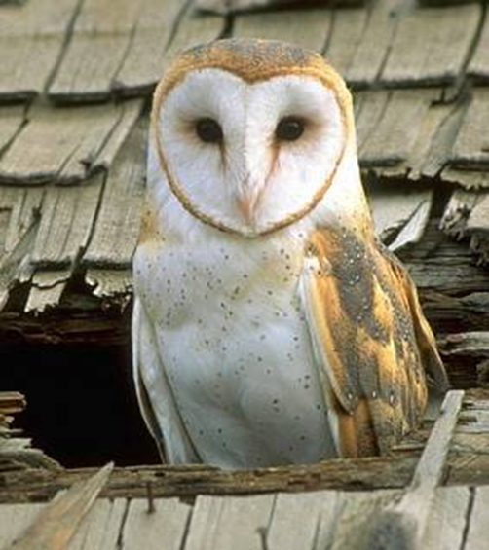
Concern 2. Widespread exposure of wildlife
Low-level residues in wildlife
Predatory Birds Monitoring Scheme and other scientific studies
Affects barn owls, red kites, kestrels, stoats, weasels, polecats, foxes, etc.
Low-level residues may have no discernible biological effect on populations BUT…………
Scientists, NGOs and government regulators are concerned that they:
  make individuals more susceptible to subsequent doses of anticoagulants
  have sub-lethal survival & fitness effects
© Copyright 2026
This presentation may be used free of charge in any format or medium provided that it is reproduced accurately and not used
in a misleading context. The material must be acknowledged as CRRU UK copyright and the title of the document specified.
Notes:
Environmental Concern About Rodenticides (2)
TAKE HOME MESSAGE – IT IS INCREASINGLY RECOGNISED THAT A VERY WIDE RANGE OF UK WILDLIFE SPECIES IS EXPOSED TO RODENTICIDES. ALTHOUGH THIS EXPOSURE DOES NOT APPEAR TO CAUSE ANY SIGNIFICANT DISCERNIBLE EFFECTS, ITS SCOPE AND INTENSITY IS CAUSE FOR CONCERN.
The most well-known case of pesticide residues adversely affecting wildlife is that of DDT and its effect on the breeding performance of birds of prey caused mainly by egg-shell thinning. After the effects of DDT were realised the bodies of birds of prey, found dead from a wide variety of causes, were analysed for residues of DDT and other pesticides. In this way, levels of pesticide residues in these ‘top predators’ are monitored. The scheme by which this is done is called the Predatory Birds Monitoring Scheme (PBMS). The results of the PBMS are published on-line at: https://pbms.ceh.ac.uk/ .
The Scheme is run by the Centre for Ecology & Hydrology (CEH) and is funded jointly by The Predatory Bird Monitoring Scheme is run by the Centre for Ecology and Hydrology (CEH) and is currently funded by The Natural Environment Research Council (through CEH’s National Capability programme), Natural England and The Campaign for Responsible Rodenticide Use.
For many years the PBMS has monitored the frequency of anticoagulant rodenticide residues in predatory birds, including barn owls, red kites and kestrels. Occasionally samples of tawny owls and other birds are examined for residues. This analysis is conducted because of concern among ecologists and regulatory bodies caused by the widespread distribution of rodenticide residues in wildlife.

Slide 18
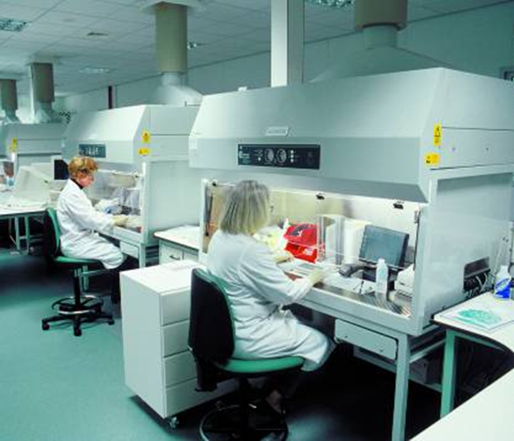
Widespread exposure of wildlife –
Carcass Analysis
Samples for analysis from a wide range of sources
Most wildlife samples result of death from road traffic collisions, other accidents and shooting
Samples sent for residue analysis to University and government laboratories for:
  Post-mortem examination
  Chemical extraction of tissues (mainly liver)
Chemical residue analysis
Analytical methods change over time, affecting the compounds that can be detected and limits of detection
© Copyright 2026
This presentation may be used free of charge in any format or medium provided that it is reproduced accurately and not used
in a misleading context. The material must be acknowledged as CRRU UK copyright and the title of the document specified.
Notes:
TAKE HOME MESSAGE – MANY DIFFERENT AGENCIES ARE STUDYING THE EXPOSURE OF WILDLIFE TO RODENTICIDES BY ANALYSING THE BODIES FOR RESIDUES USING THE MOST ADVANCED AND SENSITIVE TECHNIQUES.
Many different studies, at a range of academic and scientific institutions, have demonstrated this exposure by analysing the dead bodies of wildlife for rodenticide residues.
Residues of pesticides in wildlife species are routinely monitored within the Predatory Birds Monitoring Scheme (PBMS). In this scheme, the bodies of wildlife found dead, mainly by members of the public, are sent to the Centre for Ecology and Hydrology (CEH) for analysis. The results of the PBMS are published annually on-line at: https://pbms.ceh.ac.uk/ .
In Scotland, Science and Advice for Scottish Agriculture (SASA) also conducts both regular surveys across a range of species and occasional specific in-depth surveys on specific species. Reports from SASA are to be found here: https://www.sasa.gov.uk/
CRRU was established to address the issue of residues of rodenticides in wildlife and is doing this by making the issue more widely understood by rodenticide users and by proposing use practices that reduce wildlife exposure.
The UK Rodenticide Stewardship Regime was later established, and coordinated by CRRU, with the aim of changing rodenticide use practices so that wildlife exposure, and consequent wildlife contamination is significantly and measurably reduced.

Slide 19
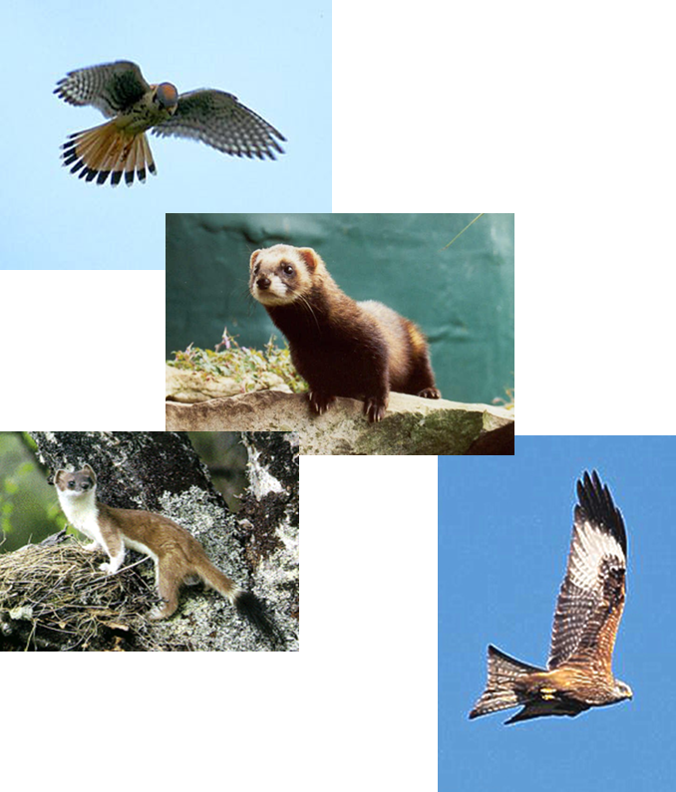
Wildlife Exposure - the anticoagulant fingerprint
Many different species exposed to SGARs
Residues in high percentage of individuals in some populations
Geographically widespread across UK
Suspect main route of contamination is outdoor/rural use of rodenticides
Contamination via multiple food-chains:
  via target mice and rats into polecats, red kites and buzzards
  via non-target small mammals into kestrels, owls, stoats and weasels
  via non-target birds into sparrowhawks and peregrines
© Copyright 2026
This presentation may be used free of charge in any format or medium provided that it is reproduced accurately and not used
in a misleading context. The material must be acknowledged as CRRU UK copyright and the title of the document specified.
Notes:
TAKE HOME MESSAGE – WIIS IS AN ESSENTIAL TOOL FOR MONITORING EXPOSURE OF WILDLIFE TO RODENTICIDES. THE INFORMATION IT PROVIDES HAS CHANGED LITTLE OVER THE YEARS. A WIDE RANGE OF SPECIES IS AFFECTED. BUT WIIS GIVES REASSURANCE THAT DETECTABLE IMPACTS ARE NOT SEVERE AND INCIDENTS ARE VERY RARE WHEN RODENTICIDES ARE USED PROPERLY.
Annual data on these exposures are collated and published as WIIS quarterly reports. These are available on-line at: http://www.hse.gov.uk/pesticides/topics/reducing-environmental-impact/wildlife/wiis-quarterly-reports.htm

Slide 20
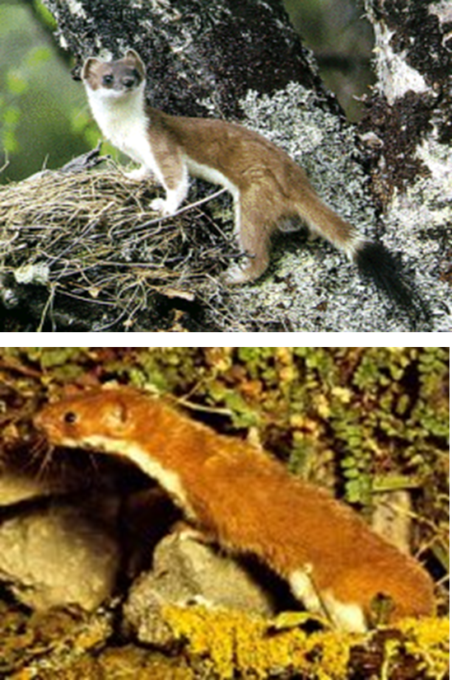
Low-level Residues – Stoats and Weasels
University of Bristol study on game estates in UK
Use of rodenticides likely to be substantial on such estates
23% of stoats contaminated (coumatetralyl, bromadiolone, brodifacoum)
30% of weasels contaminated (coumatetralyl, bromadiolone)
Main route of contamination thought to be via non-target rodents and rodenticide use at pheasant rearing pens and feeders
© Copyright 2026
This presentation may be used free of charge in any format or medium provided that it is reproduced accurately and not used
in a misleading context. The material must be acknowledged as CRRU UK copyright and the title of the document specified.
Notes:
Low-level Residues – Stoats and Weasels
The sample of stoats and weasels taken for analysis by the workers from the University of Bristol were from game estates and, therefore, may not be representative of the UK populations of these species because rodenticides are extensively used in game-rearing. It is interesting to note that this study is one of the few to have found contamination of wildlife with a first-generation anticoagulant, coumatetralyl, presumably acquired by these carnivorous animals via secondary poisoning.
For more on this see:
McDonald, R. A., S. Harris, et al. (1998). "Anticoagulant rodenticides in stoats (Mustela erminea) and weasels (Mustela nivalis) in England." Environmental Pollution 103(1): 17-23.

Slide 21
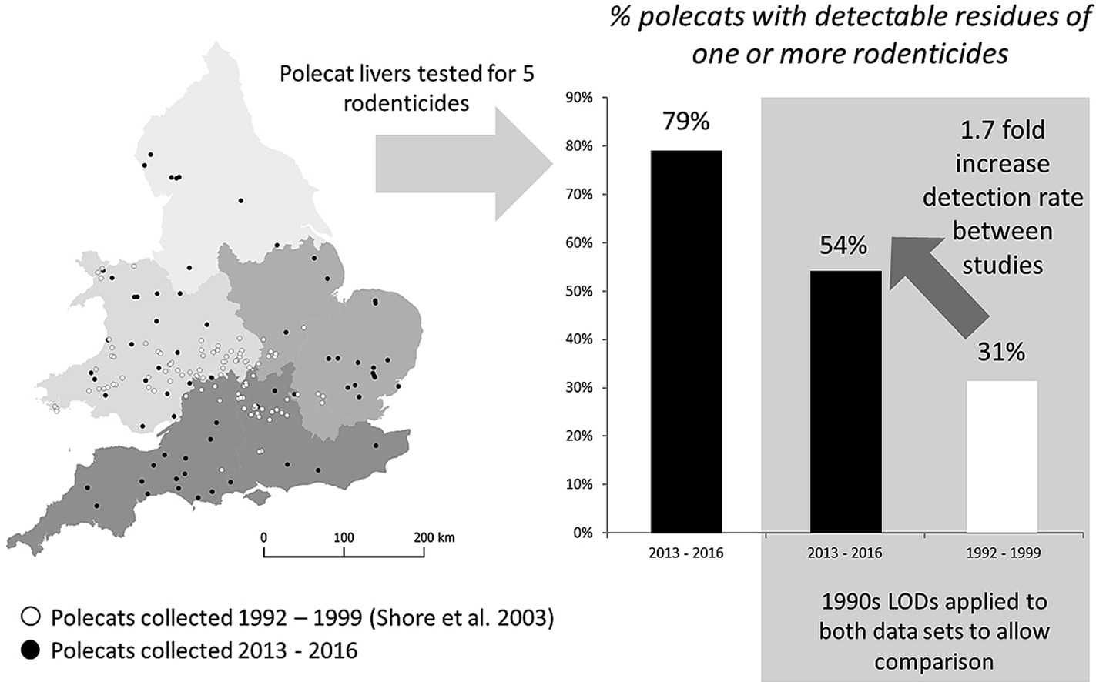
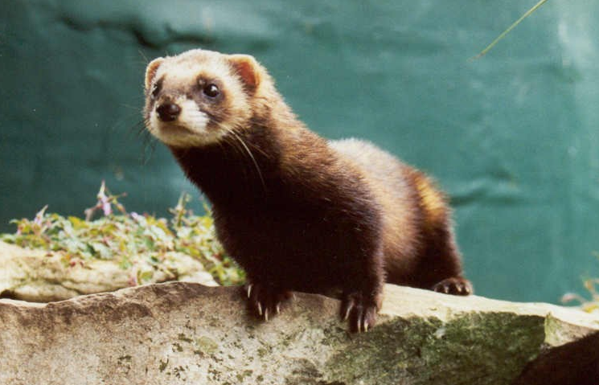
Low-level Residues – Polecats
Polecats rapidly spreading across England from Wales
Studies conducted 1993-2016
79% of individuals with anticoagulant residues
Contamination via rats and mice when polecats use farmsteads in winter
Sainsbury et al., 2018
© Copyright 2026
This presentation may be used free of charge in any format or medium provided that it is reproduced accurately and not used
in a misleading context. The material must be acknowledged as CRRU UK copyright and the title of the document specified.
Notes:
Low-level Residues – Polecats
Polecats were once extremely rare in the UK and were largely restricted to a remnant population in central Wales. The reason for this was persecution. With the recent relaxation in persecution, polecats are rapidly extending their range in the UK, from their Welsh stronghold into the Midlands and, even, into eastern and southern England. Although polecats mainly prey on rabbits, they may also take small mammals in hedgerows and rodent pest species in hedgerows and on farmsteads. This has resulted in their contamination with anticoagulant rodenticides. However, this does not appear to be having and obvious effect on the UK polecat population, which is rapidly recovering from persecution, both in terms of the numbers of individuals present and increasing geographical distribution of the species across the UK.
For more on this see:
Sainsbury, K.A., Shore, R.F., Schofield, H., Croose, E., Pereira, M.G., Sleep, D., Kitchener, A.C., Hantke, G. and McDonald, R.A., 2018. Long-term increase in secondary exposure to anticoagulant rodenticides in European polecats Mustela putorius in Great Britain. Environmental Pollution, 236, pp.689-698.
https://www.sciencedirect.com/science/article/abs/pii/S0269749117349035
Birks, J. D. S. and A. C. Kitchener (1999). The distribution and status of the Polecat Mustela putorius in Britain in the 1990s, The Vincent Wildlife Trust: 152 pp.

Slide 22
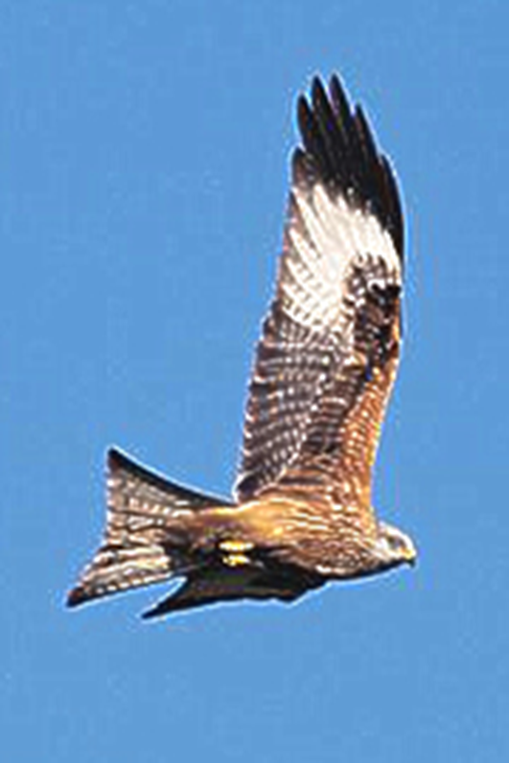
Low-level Residues – Red Kites
Re-introduced by Natural England to sites in England, Northern Ireland and Scotland
At forefront of recent concern about anticoagulants from conservation bodies
Deaths of individual birds may impact growth of new colonies
100% of 14 dead red kites analysed in 2022 carried anticoagulant residues
(Overall figures 94% when all PBMS data considered – 204 of 216 red kites)
Contamination via consumption of bodies of rats and mice on farms and in the countryside
© Copyright 2026
This presentation may be used free of charge in any format or medium provided that it is reproduced accurately and not used
in a misleading context. The material must be acknowledged as CRRU UK copyright and the title of the document specified.
Notes:
Low-level Residues – Red Kites
Red kites take a wide variety of prey and will often feed on carrion. It is not surprising, therefore, that they are the wildlife species that is found to carry residues of anticoagulants most frequently. Kites are probably exposed when they take the carcases of dead rats which are not disposed of safely during baiting campaigns.
Like polecats, Red kites were threatened with extinction in the UK because of persecution. For almost 100 years the UK population was restricted to a few individuals in the extreme west of Wales. However, a successful programme of re-introduction of kites taken from populations in Europe was instigated by English Nature (now Natural England). Populations of kites are now established at several sites in the UK. The population at the first re-introduction site in the Chilterns is particularly abundant.
For more information see:
Ozaki, S., Barnett, E.A., Carter, H., Chaplow, J.S., Charman, S., Pereira, M.G., Potter, E.D., Sainsbury, A.W., Shadbolt, T., Sleep, D. and Sharp, E.A., 2024. Second generation anticoagulant rodenticide residues in red kites 2022.
https://pbms.ceh.ac.uk/sites/default/files/PBMS_Red_Kite_2022_FINAL.pdf
Burn, A. J., I. Carter, et al. (2002). "The threats to birds of prey in the UK from second-generation rodenticides." Aspects of Applied Biology 67: 1-10.
Carter, I. and P. Grice (2000). "Studies of re-established Red Kites in England." British Birds 93(7): 304-322.

Slide 23
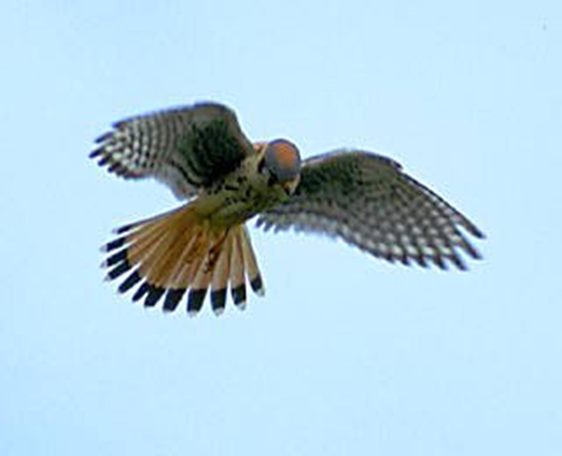
Low-level Residues – Kestrels
UK Kestrel population may be declining – cause is unknown and conservationists looking for a reason
Other species increasing (peregrine, red kite, buzzard, tawny owl)
Suspicion is turning towards anticoagulants
67% of kestrels carry anticoagulant residues – surprising finding
Contamination via non-target small mammals
© Copyright 2026
This presentation may be used free of charge in any format or medium provided that it is reproduced accurately and not used
in a misleading context. The material must be acknowledged as CRRU UK copyright and the title of the document specified.
Notes:
Low-level Residues – Kestrels
Kestrels are rarely found to take pest rats and mice as food. They feed mainly on small rodents, such as wood mice, bank voles and field voles. Therefore, it was somewhat surprising that a relatively high proportion of kestrels was found to carry residues of rodenticides. It was this finding, more than any other, that led conservationists to think that the route of exposure of wildlife to anticoagulant rodenticides may be via non-target small mammals, as well as via target rats and mice.
The UK has one of the largest populations of kestrels in Europe and current estimates are that there may be between 35 and 50 thousand pairs nesting in Britain. However, there is some recent evidence that kestrel numbers in the UK may be declining. The reasons for this are uncertain, although declining numbers of their small mammal prey may have played a part.
For more information see:
Burn, A. J., I. Carter, et al. (2002). "The threats to birds of prey in the UK from second-generation rodenticides." Aspects of Applied Biology 67: 1-10.
Village, A. (1982). "The diet of Kestrels in relation to vole abundance." Bird Study 29: 129-138.
Village, A. (1990). The Kestrel. London, T & AD Poyser.

Slide 24
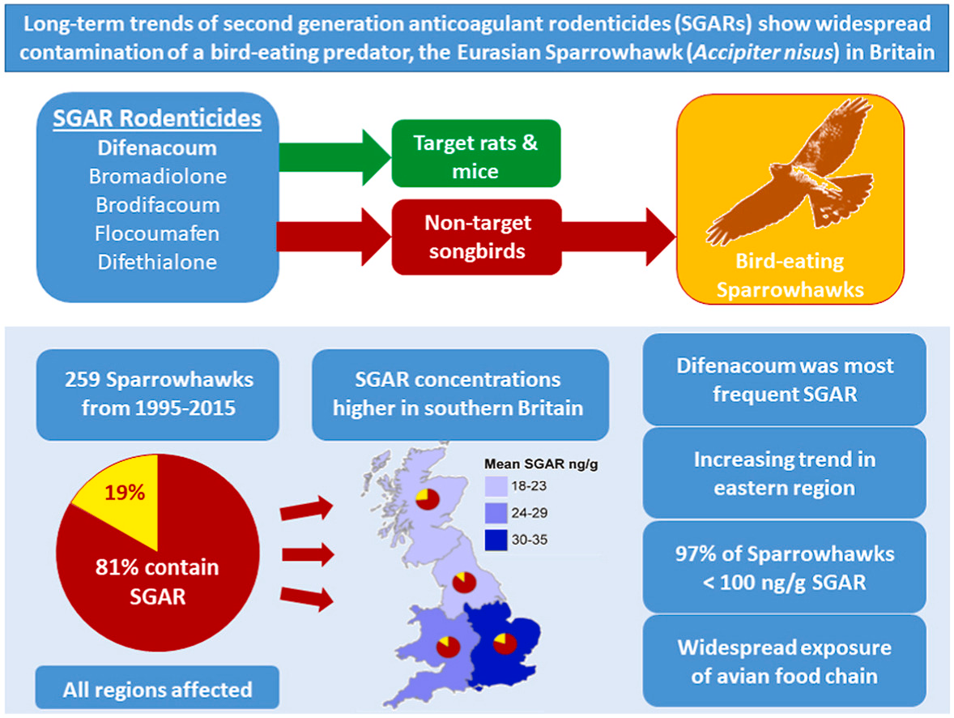
Low-level residues
- Sparrowhawks
Residues in sparrowhawks
259 birds from 1995 - 2015, 81% contained SGARs
Mainly catch small birds on the wing, so these prey species also carry SGARs
Broughton et al., 2022
© Copyright 2026
This presentation may be used free of charge in any format or medium provided that it is reproduced accurately and not used
in a misleading context. The material must be acknowledged as CRRU UK copyright and the title of the document specified.
Notes:
Broughton, R.K., Searle, K.R., Walker, L.A., Potter, E.D., Pereira, M.G., Carter, H., Sleep, D., Noble, D.G., Butler, A. and Johnson, A.C., 2022. Long-term trends of second generation anticoagulant rodenticides (SGARs) show widespread contamination of a bird-eating predator, the Eurasian Sparrowhawk (Accipiter nisus) in Britain. Environmental Pollution, 314, p.120269.
https://www.sciencedirect.com/science/article/pii/S026974912201483X

Slide 25
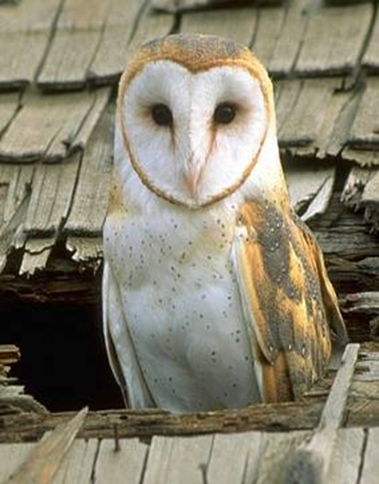
Sentinel species for wildlife exposure to SGARs – the Barn Owl
Only for the barn owl do we:
  obtain enough carcases for residue analysis on an annual basis
  have a long historical data set
  have baseline data allowing us to track statistical trends in exposure data for anticoagulants
CRRU UK contracts Centre for Ecology & Hydrology to conduct annual residue survey as one of the key monitoring programmes for the Stewardship Regime
© Copyright 2026
This presentation may be used free of charge in any format or medium provided that it is reproduced accurately and not used
in a misleading context. The material must be acknowledged as CRRU UK copyright and the title of the document specified.
Notes:
TAKE HOME MESSAGE – THE BARN OWL IS THE MOST IMPORTANT WILDLIFE SPECIES IN TERMS OF MONITORING THE OVERALL EXTENT OF WILDLIFE EXPOSURE BECAUSE IT HAS BEEN CHOSEN AS THE SENTINEL SPECIES
Several considerations have resulted in the use of the barn owl as the sentinel species for exposure of wildlife. We have been monitoring this species for more than forty years, so we have historical data going back decades. This permits the establishment of base-line measures against which we can compare future changes. Acquiring dead barn owls for analysis is relatively easy (except in avian flu outbreaks) – we need at least 100 each year for statistical analysis. They are widespread across the country, though less common in Scotland, so they exemplify the wider UK environment. That said, we believe they are contaminated mainly by the consumption of non-target small mammals. So they only accurately represent this route of exposure.
https://pbms.ceh.ac.uk/sites/default/files/PBMS-Stewardship-2022-owls_FINAL.pdf

Slide 26
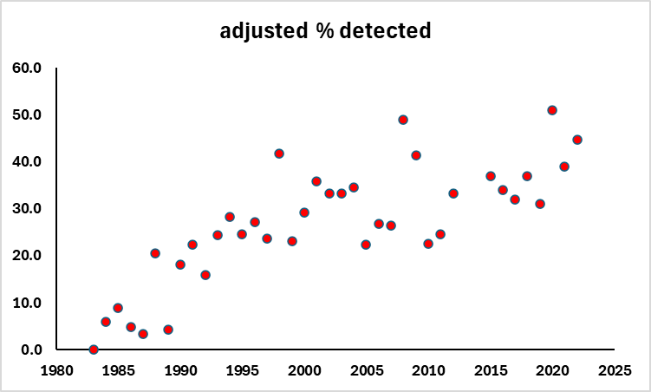
Long-term data set - Barn Owls
Percentage of barn owls with residues of anticoagulant rodenticides
Recently, 30-50% barn owls carry one or more SGAR residues
Residues are ‘stubbornly static’
These are ‘corrected’ values to permit comparisons with earlier analytical methods
Significant increase in the % owls carrying residues during 1985-2000 ………..why?
Data from the Predatory Birds Monitoring Scheme provided by Lee Walker, UKCEH
© Copyright 2026
This presentation may be used free of charge in any format or medium provided that it is reproduced accurately and not used
in a misleading context. The material must be acknowledged as CRRU UK copyright and the title of the document specified.
Notes:
TAKE HOME MESSAGE – THERE IS NO OBVIOUS SINGLE REASON FOR THE INCREASE IN THE PERCENTAGE OF BARN OWLS CONTAMINATED OVER THE MONITORING PERIOD.
The data given on the slide come from Lee Walker of the UKCEH and are reported in detail via reports of the Predatory Birds Monitoring Scheme . http://pbms.ceh.ac.uk.
The slide shows the % of owls that carry residues of one or more anticoagulant rodenticide. There has been a steady increase in the percentage of owls carrying SGAR residues.
Some thought that increasing levels of contamination may have been due to an increase in the sensitivity of analytical methods. However, the scientists who carry out the PBMS survey check for this by conducting analysis retrospectively on stored samples.

Slide 27
Barn owl – 1985-2000 increased exposure why?
Increased analytical sensitivity
  Analytical methods certainly improved but PBMS scientists correct for this is the long-term data – so not this
Changes in feeding habits
  Loss of rough grassland means fewer field voles and more wood mice in barn owl diets. Wood mice more likely than field voles to take rat baits. But no sign of this change in diet studies – so not this
More rodenticides used
  Would expect more contamination if more rodenticides were used. But no evidence for large increases in use during the period in question – so not this
Increased use of outdoor permanent baiting
  During the 1980’s new pest control service contracts based prophylactic permanent baiting became popular, exposing small non-target mammals – a possible cause of increasing residues in barn owls
© Copyright 2026
This presentation may be used free of charge in any format or medium provided that it is reproduced accurately and not used
in a misleading context. The material must be acknowledged as CRRU UK copyright and the title of the document specified.
Notes:
TAKE HOME MESSAGE –. SEVERAL EXPLANATIONS HAVE BEEN EXAMINED BUT NONE CAN FULLY EXPLAIN THE INCREASE. BUT IT SEEMS LIKELY THAT CHANGE IN THE WAY WE USED RODENTICISED IN THE 1980s AND 1990s, FROM CAMPAIGN BAITING TO PERMANENT BAITING MAY HAVE BEEN INVOLVED.
There appears to have been a steady increase during the period covered in the frequency of birds carrying residues. At first it was thought that this might have been due to increases in use of products containing these compounds. However, there appears to have been no real increase in rodenticide use during this period. Instead a more subtle mechanism was suggested. During the period covered by the survey there has been a dramatic reduction in the area of rough grassland in the UK. This habitat is important for the strictly herbivorous field voles (Microtus agrestis), which is the preferred food of barn owls. However, with fewer short-tailed voles available it is thought that owls may have switched to feeding on wood mice (Apodemus sylvaticus) and bank voles (Myodes (=Clethrionomys) glareolus). These species are more omnivorous and are more likely to take grain-based rodenticides. However, studies of barn owl feeding habits during the period in question did not show any changes large enough to explain the increase seen.
However, we know that rodenticide use changed during the 1980s. There was a move away from campaign baiting of existing infestations towards preventative baiting, often in the absence of an infestation. This came to be called PERMANENT BAITING. The permanent deployment of baits in external bait boxes permits feeding by non-target small mammals, such as wood mice and voles, and these are the main prey of the barn owl.

Slide 28
Barn Owl populations
The Barn Owl Monitoring Scheme (BOMS) shows:
  7 years of data sets
  successful nesting numbers go up and down depending on several factors, including weather characteristics and prey availability.
  SGAR’s contamination has never appeared to be a factor in the relative success or failure of nesting & egg laying in monitored owls.
  No evidence of sub-lethal effects of exposure to anticoagulant rodenticides.
  ‘A good year for Barn Owls with significantly more nesting pairs than usual’ in 2024
© Copyright 2026
This presentation may be used free of charge in any format or medium provided that it is reproduced accurately and not used
in a misleading context. The material must be acknowledged as CRRU UK copyright and the title of the document specified.
Notes:
https://www.barnowltrust.org.uk/wp-content/uploads/SOUKBOP-2024.pdf

Slide 29
Contamination in some other species
Species | Country | Year(s) | Number sampled | %carrying one or more SGAR
Barn owl | UK | 2015-2022 | 800 | 84
Red kite | UK | 2015-2022 | 262 | 94
 | Scotland | 2000-10 | 114 | 69
Sparrowhawk | UK | 2010-13 | 94 | 89
 | UK | 1995-2015 | 259 | 81
Kestrel | UK | 1997-2012 | 241 | 67
Polecat | UK | 1993-99 | 100 | 31
 | UK | 2013-2016 | 68 | 79
Tawny owl | UK | 1993-99, 2013-16 | 172 | 19
Buzzard | Scotland | 2000-10 | 479 | 43
 | UK | 2001-2019 | 72 | 86
Peregrine | Scotland | 2000-10 | 24 | 29
© Copyright 2026
This presentation may be used free of charge in any format or medium provided that it is reproduced accurately and not used
in a misleading context. The material must be acknowledged as CRRU UK copyright and the title of the document specified.
Notes:
TAKE HOME MESSAGE – AGAIN, CONTAMINATION IS WIDESPREAD
This table shows details of some of the most recent surveys of wildlife contamination with SGARs. Among some of these species nearly every individual examined carries one or more SGAR residues. But it must be remembered that the anticoagulants found are usually NOT the cause of death. This is usually other causes such as collision with vehicles, other causes of trauma, disease, starvation etc. The bodies are recovered and residues of anticoagulants are investigated.

Slide 30
Contamination and changes in breeding numbers
Species | Year(s) | Number sampled | %carrying one or more SGAR | % change in breeding numbers from BBS* 1995-2022
Barn owl | 2015-22 | 800 | 84 | +208
Red kite | 2010-22 | 286 | 94 | +2232
Sparrowhawk | 1995-2015 | 353 | 83 | no change
Kestrel | 1997-2012 | 241 | 67 | -40
Tawny owl | 1993-99, 2013-16 | 172 | 19 | -36
Buzzard | 2000-19 | 551 | 49 | +80
Peregrine | 2000-10 | 24 | 29 | -43
* Data from British Trust for Ornithology Breeding Bird Survey 2024
No clear correlation between exposure & changes in breeding numbers
Some contaminated species have shown significant population increases throughout a period of widespread and SGAR exposure
© Copyright 2026
This presentation may be used free of charge in any format or medium provided that it is reproduced accurately and not used
in a misleading context. The material must be acknowledged as CRRU UK copyright and the title of the document specified.
Notes:
TAKE HOME MESSAGE- POPULATIONS OF SOME CONTAMINATED SPECIES, RED KITE, BARN OWL AND BUZZARD, ARE INCREASING.
Changes in the size of UK breeding bird populations are seldom attributable to a single cause. Often several factors combine to cause increases or decreases and these factors differ between species. Barn owls are increasing, at least in part, because of intensive programmes of conservation led by organisations such as the Barn Owl Trust (https://www.barnowltrust.org.uk/). There have been schemes releasing captive bred birds (now stopped) and programmes to provide thousands of next boxes in areas where nest sites are few. The phenomenal increase in the red kite is due to the release of captive bred birds and programmes of supplementary feeding to aid population establishment. Massive recent increases in buzzard numbers is largely due to the release from pressures caused by illegal persecution by game interests during the early 20th century. The numbers of all these birds are increasing, as is their geographical distribution. The reasons for the declines of some of the other species is uncertain. However, dramatic increases of two of the large raptor species, and others not listed here (i.e. raven, Corvus corax and goshawk, Accipiter gentilis ), probably has some detrimental impacts on smaller raptors such as kestrel and tawny owl.
There is no evidence that low-level residues of anticoagulants, although pervasive, have an effect on populations of those species which carry them. But in spite of this we are required to reduce wildlife contamination because insidious and unrecognised sub-lethal effects can never be ruled out with absolute certainty.

Slide 31
Concern 2: Low Level Residues - Summary
Residues of anticoagulants are in a variety of non-target species, many of high conservation value
Residues occur in a high proportion of individuals within populations
Dietary studies suggest that contamination occurs BOTH from taking non-target small mammals (field mice and voles) AND from taking target rats and mice
Likely source of this contamination is from use of rodenticides externally, particularly in areas where wildlife is abundant
No evidence of any adverse effects of these residues, i.e. populations of many of the most contaminated species are increasing rapidly
But sub-lethal effects cannot be ruled out
© Copyright 2026
This presentation may be used free of charge in any format or medium provided that it is reproduced accurately and not used
in a misleading context. The material must be acknowledged as CRRU UK copyright and the title of the document specified.
Notes:
TAKE HOME MESSAGE – ANTICOAGULANT RODENTICIDES CONTAMINATE WILDLIFE. USE PRACTICES MUST CHANGE TO PREVENT ALL UNECESSARY EXPOSURE (one reason why ‘open area’ use of anticoagulants was withdrawn)
Low-level residues of pesticides in wildlife species are monitored within the Predatory Birds Monitoring Scheme (PBMS). The results of the PBMS are published annually and an interpretation of the biological processes that bring about these residues and their significance is also provided. More information is available on-line at: http://pbms.ceh.ac.uk/

Slide 32
General Conclusions
No evidence that either wildlife fatalities or low-level contamination is having significant adverse affect on wildlife populations
Populations of many key species are expanding due to conservation efforts and removal of persecution (e.g. red kite, buzzard, polecat)
  But…Wildlife fatalities and widespread low-level residues are of concern to everyone
  Those who use rodenticides must use them responsibly so as to minimise all wildlife exposure
  The success if the UK Rodenticide Stewardship Regime will be judged on demonstrated reductions in wildlife exposure
  Without this success more restrictions on the use of rodenticides are inevitable
© Copyright 2026
This presentation may be used free of charge in any format or medium provided that it is reproduced accurately and not used
in a misleading context. The material must be acknowledged as CRRU UK copyright and the title of the document specified.
Notes:
TAKE HOME MESSAGE – FATALITIES OF INDIVIDUAL ANIMALS AND WIDLESPREAD CONTAMINATION ARE IMPORTANT CONCERNS BUT ARE PROBABLY NOT CAUSING SIGNIFICANT POPULATION IMPACTS. HOWEVER, EXPOSURE MUST BE REDUCED BY IMPROVING USE PRACTICES OR MORE RESTRICTIONS WILL BE APPLIED BY REGULATORS
A more detailed discussion of these issues is given in the references cited throughout this presentation and an overview is provided at the CRRU UK web-site: http://www.thinkwildlife.org.uk

Slide 33

Thank you
© Copyright 2026
This presentation may be used free of charge in any format or medium provided that it is reproduced accurately and not used
in a misleading context. The material must be acknowledged as CRRU UK copyright and the title of the document specified.

