Slide 1
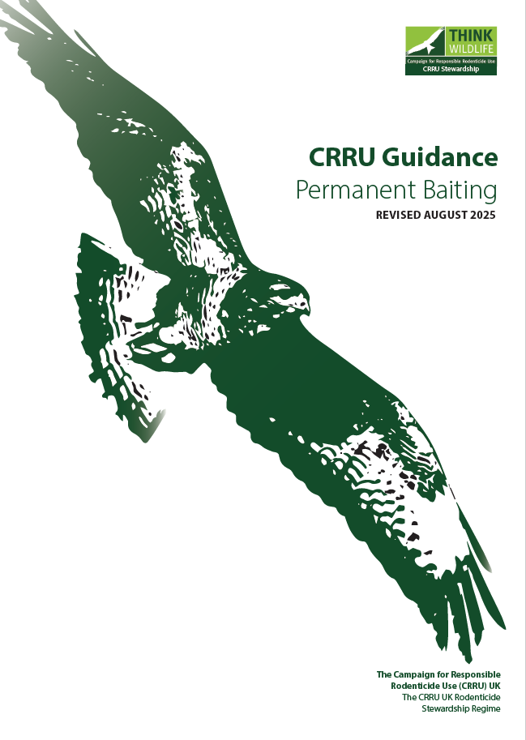
Permanent baiting
(guidance and explanation)
CRRU UK
A training resource for:
Continuing Professional Development
© Copyright 2026
This presentation may be used free of charge in any format or medium provided that it is reproduced accurately and not used
in a misleading context. The material must be acknowledged as CRRU UK copyright and the title of the document specified.
Notes:
Presentation to be used alongside https://thinkwildlife.org/download/crru-guidance-on-permanent-baiting-revised-august-2025/?wpdmdl=19153&refresh=695e5fe2659cd1767792610
Note that images of rodent control products are omitted from this CRRU UK presentation. Trainers can add their own images for illustration.

Slide 2
The guidelines:
These cover…
When permanent baiting can be used
Products that can be used
Labelling
Precautions necessary
© Copyright 2026
This presentation may be used free of charge in any format or medium provided that it is reproduced accurately and not used
in a misleading context. The material must be acknowledged as CRRU UK copyright and the title of the document specified.

Slide 3
What is permanent baiting?
Rodenticide that is…
Left out in protected, usually tamper-resistant, bait stations in places where there are no current signs of rodent infestation but where there is an ongoing and high threat of rodent infestation
© Copyright 2026
This presentation may be used free of charge in any format or medium provided that it is reproduced accurately and not used
in a misleading context. The material must be acknowledged as CRRU UK copyright and the title of the document specified.

Slide 4
Was rodenticide intended to be used in this way?
Rodenticide was never intended to be used as permanent baits
Rodenticides were designed to be placed for the treatment duration and then removed at the end of the treatment / when the area had been cleared
They were intended for use where there are pest rodents
© Copyright 2026
This presentation may be used free of charge in any format or medium provided that it is reproduced accurately and not used
in a misleading context. The material must be acknowledged as CRRU UK copyright and the title of the document specified.

Slide 5
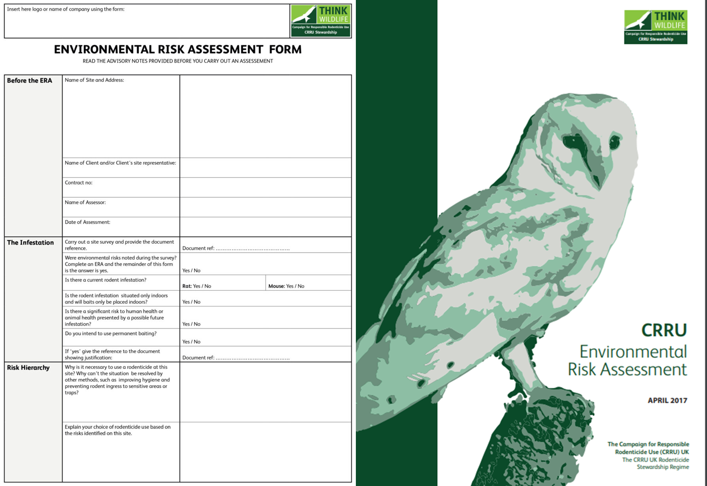
Routine permanent baiting?
Permanent use of rodenticides was a routine practice for many years
The theory is that this was / is the main route of wildlife contamination
Although permanent baiting should not be routine, there is still a time and a place for this practice
The time and place will be designated by the:
Situation that requires treatment
Environmental Risk Assessment (ERA)
Level of threat to human or animal health and hygiene
© Copyright 2026
This presentation may be used free of charge in any format or medium provided that it is reproduced accurately and not used
in a misleading context. The material must be acknowledged as CRRU UK copyright and the title of the document specified.
Notes:
Consideration of wildlife is part of a professional approach.
CRRU UK Chairman Nigel Cheeseright says:
“In support of our ongoing commitment to responsible pest management and the reduction of
rodenticide residues in non-target wildlife, it is important that all users of professional use rodenticides
understand that permanent baiting practices have the potential to be one of the main causes
of wildlife contamination, if not performed in line with the CRRU UK Code of Best Practice and CRRU
Guidance on Permanent Baiting.
All professional practitioners need to recognise their obligations to examine the risk to non-targets
species (environmental risk assessment) and make a conscious decision that those risks are justified
by a continuing threat to human or animal health and hygiene. These risks should be periodically
assessed during any treatment to spot for signs of non-target species activity.
This permanent baiting guide provides professional users with the information they need to manage
challenging rodent infestations, whilst minimising the impact to the environment”

Slide 6
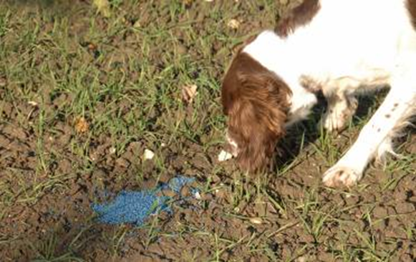
Permanent baiting – the main issues
Protected – keeping bait preparations covered in tamper-resistant boxes or covered and protected bait points. Ensuring baits are kept away from non-targets (people, other wildlife and pets)
Stability – formulation: many cannot remain palatable and in good condition for long periods externally (grains and pellets may degrade)
© Copyright 2026
This presentation may be used free of charge in any format or medium provided that it is reproduced accurately and not used
in a misleading context. The material must be acknowledged as CRRU UK copyright and the title of the document specified.
Notes:
Protected from the surrounding environment, while also considering rodent box placement and adhering to the label.
Formulation or preparation: the matrix the manufacturers have used as the carrier for the rodenticide and the main attractant in the product.

Slide 7
Permanent baiting – overcoming the issues
Consider tamper-resistant lockable rodent boxes that are fixed in position
Carry out an Environmental Risk Assessment to identify non-target wildlife and mitigate risks
Consider preparations authorised for permanent baiting that are more stable when subjected to external environmental conditions
© Copyright 2026
This presentation may be used free of charge in any format or medium provided that it is reproduced accurately and not used
in a misleading context. The material must be acknowledged as CRRU UK copyright and the title of the document specified.
Notes:
Formulations based on wax blocks permits baits to be put out for long periods, and remain in good condition, making them useful in permanent baiting

Slide 8
When should permanent baiting be used?
When there is no current rodent activity but an unacceptable risk to human or animal health and a significant ongoing threat of infestation / reinvasion has been identified
Using rodenticide treatment during an active infestation would either fall within the 35 days period (as per product labels), or be long-term baiting with the full intention and requirement of removal at the end of the treatment
© Copyright 2026
This presentation may be used free of charge in any format or medium provided that it is reproduced accurately and not used
in a misleading context. The material must be acknowledged as CRRU UK copyright and the title of the document specified.

Slide 9

What about audit standards?
There has been a misconception that some audit standards specify permanent baiting – this is no longer the case
Customer education may be required if you are asked to perform permanent baiting as part of a contract when it is not necessary
Audit specifications will now refer to the local legislation and the CRRU UK Code of Best Practice, which includes guidance notes such as the guide to permanent baiting
© Copyright 2026
This presentation may be used free of charge in any format or medium provided that it is reproduced accurately and not used
in a misleading context. The material must be acknowledged as CRRU UK copyright and the title of the document specified.

Slide 10

Long-term baiting
Generally, ‘rodent infestation can be cleared in 35 days or fewer’
Going beyond this time-period, with rodent activity persisting, is long-term baiting with a plan to remove rodenticide at the end of treatment
The 35-day period allows hierarchical feeding behaviour by the rodent colony. The dominant adults typically feed first, followed by the sub-dominant adults, then juveniles
© Copyright 2026
This presentation may be used free of charge in any format or medium provided that it is reproduced accurately and not used
in a misleading context. The material must be acknowledged as CRRU UK copyright and the title of the document specified.

Slide 11
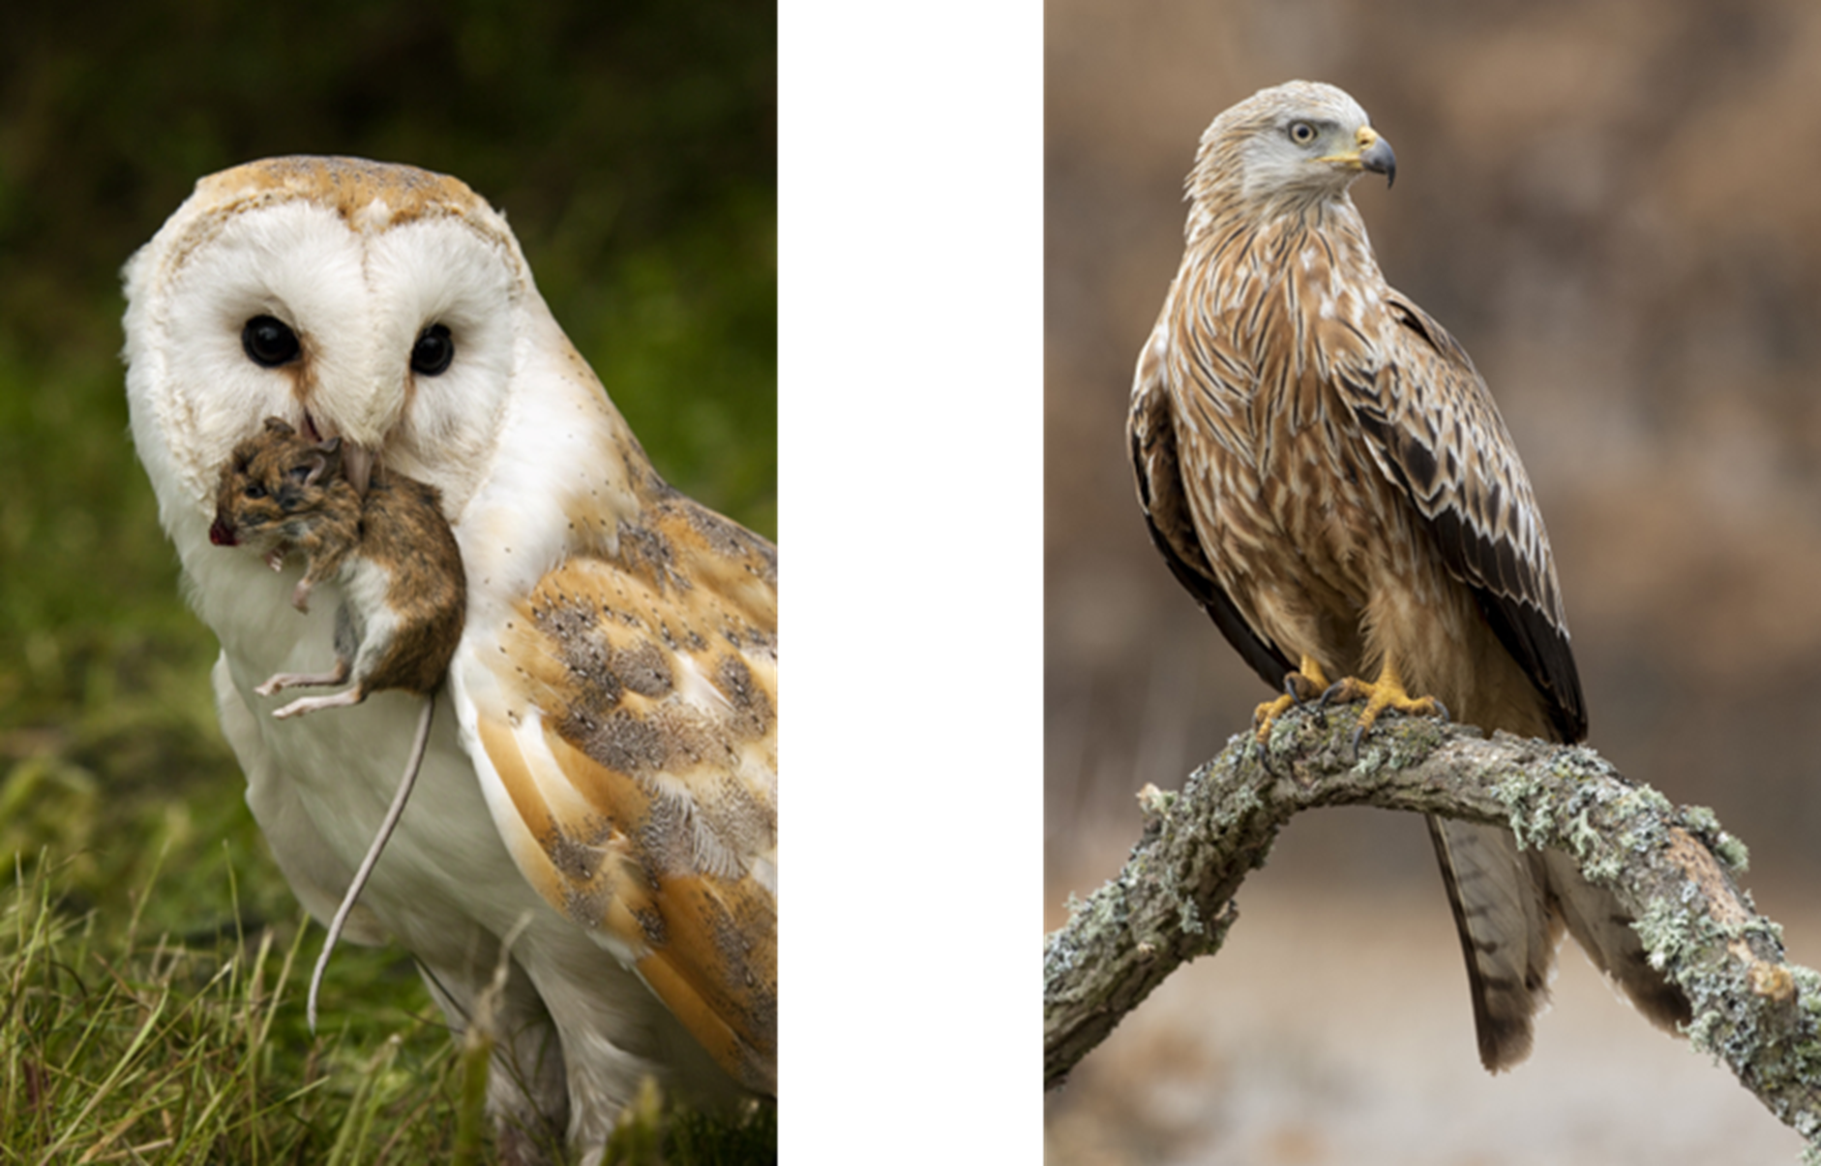
Why permanently bait?
If we know that there is a risk to non-target wildlife then why permanently bait at all?
In any normal situation permanent baiting would not be required
To permanently bait we must consider the entire situation, the risks of rodent infestation to premises and neighbouring premises
If a risk to non-target species is identified and cannot be mitigated, then another treatment option should be considered
© Copyright 2026
This presentation may be used free of charge in any format or medium provided that it is reproduced accurately and not used
in a misleading context. The material must be acknowledged as CRRU UK copyright and the title of the document specified.

Slide 12
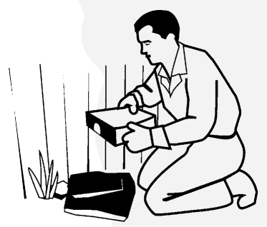
Why was permanent baiting done?
Rodent management carried out using rodenticides
Having baits in place prior to an infestation occurring (the idea that prevention is better than cure or consequential treatments)
Technicians would visit the premises on contract between 4 and 8 weeks
The intention to protect ‘at risk’ facilities between technician visits
In a ‘monitoring’ capacity – although non-toxic monitors are available
We are now better informed and much more aware of the environmental impact of certain treatments
© Copyright 2026
This presentation may be used free of charge in any format or medium provided that it is reproduced accurately and not used
in a misleading context. The material must be acknowledged as CRRU UK copyright and the title of the document specified.

Slide 13
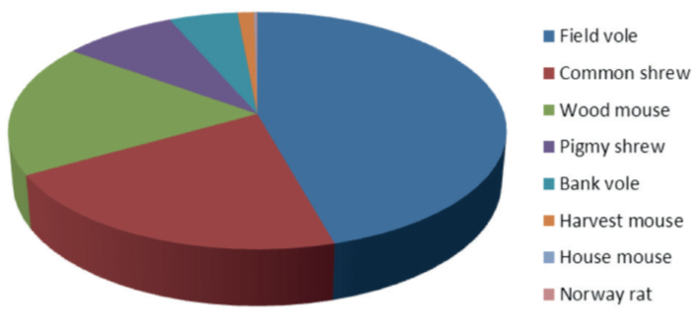
Why is permanent baiting an issue?
Not just target species enter bait stations
Many other wild rodent species and other wild animals could enter some bait stations
One of the main concerns is Apodemus sylvaticus the field or wood mouse
The chart shows the constituent diet of the barn owl, the sentinel species for CRRU UK monitoring of anticoagulant residues
© Copyright 2026
This presentation may be used free of charge in any format or medium provided that it is reproduced accurately and not used
in a misleading context. The material must be acknowledged as CRRU UK copyright and the title of the document specified.
Notes:
The figure shows the percentage of different prey species in the food of barn owls in the UK. The figures are aggregate
data from surveys conducted in the UK during the period 1974 to 1997 and are adjusted for mean prey weight. The
contributions to the diet of owls of the rodent species that are the targets for anticoagulant treatments, Norway
rats and house mice, are too small to register on the chart. This leads us to believe that the majority of rodenticide
contamination of barn owls is caused by consumption of contaminated non-target small mammals. [Note: barn
owl diets are very variable and the diets of individual owls may vary considerably from that shown in the figure.]
It may be no coincidence that it was during the 1980s and 1990s, as the practice of permanent baiting became
more common in the UK, that barn owls were becoming increasingly contaminated with rodenticides. There
is no other convincing explanation for this fact because the amounts of rodenticides being used were not
increasing at that time, nor were there significant differences in methods of chemical analysis that would have
made rodenticide residues in barn owls easier to find.

Slide 14
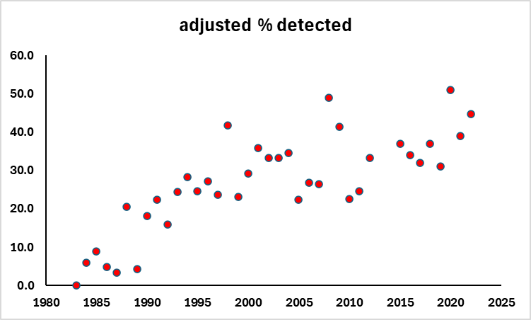
Why is permanent baiting an issue?
Since the 1980’s SGAR (Second Generation Anticoagulant Rodenticides) residues have been detected in barn owls (as detected by the PBMS)
This is in line with predatory birds consuming rodents containing SGAR residues
Birds may contain residues of more than one SGAR
Percentage of barn owls with residues of anticoagulant rodenticides
Data from the Predatory Birds Monitoring Scheme provided by Lee Walker, UKCEH
© Copyright 2026
This presentation may be used free of charge in any format or medium provided that it is reproduced accurately and not used
in a misleading context. The material must be acknowledged as CRRU UK copyright and the title of the document specified.
Notes:
PBMS – Predatory bird monitoring scheme.
This figure shows: The percentage of barn owls that carry detectable residues of one or more of the five second-generation
anticoagulants in use in the UK. There appeared to be a consistent increase in the numbers of owls with residues
in the period 1985 to 2000. Thereafter the data are highly variable and show no reliable trend. The values are
adjusted to allow consistent reporting in spite of improvements in analytical techniques. Surveys of rodenticide use
during the period 1985 to 2000, conducted by government scientists, showed no significant increases in the overall
quantities of rodenticides applied in UK during that period. [The figure is reproduced here with the kind permission
of the Centre for Ecology & Hydrology.]

Slide 15
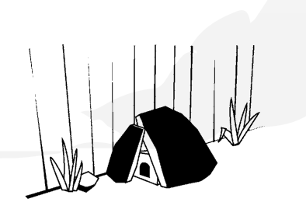
Not just wild rodents enter bait stations
Bird droppings are sometimes seen in bait stations
Some birds overcome their reluctance to go into bait boxes, enter and take bait
This may partly explain why sparrowhawks and peregrines carry residues of anticoagulants
These birds rarely take rodent prey and feed almost entirely on other birds taken in flight
© Copyright 2026
This presentation may be used free of charge in any format or medium provided that it is reproduced accurately and not used
in a misleading context. The material must be acknowledged as CRRU UK copyright and the title of the document specified.

Slide 16
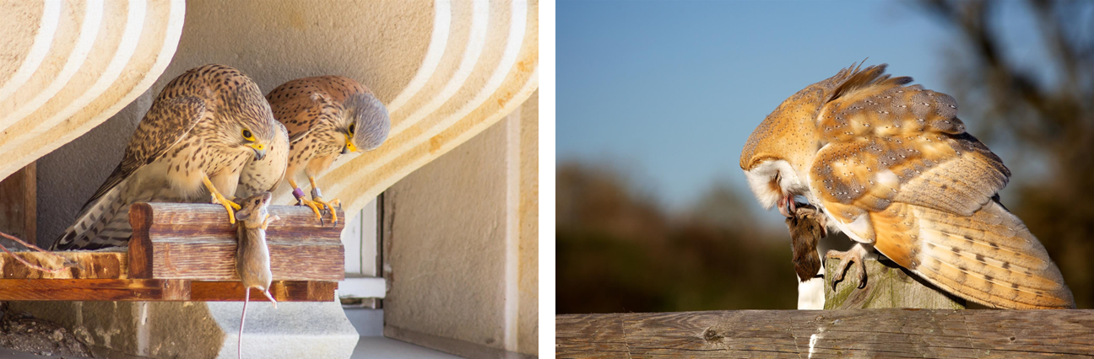
CRRU UK objectives
Reducing anticoagulant rodenticide residues in UK wildlife is an objective
CRRU UK believes that a reduction in permanent baiting will contribute to a reduction of residues in wildlife
When anticoagulant rodenticide residues enter non-target animals, this becomes an uncontrolled use of rodenticide
© Copyright 2026
This presentation may be used free of charge in any format or medium provided that it is reproduced accurately and not used
in a misleading context. The material must be acknowledged as CRRU UK copyright and the title of the document specified.

Slide 17
Indoors vs around buildings –
what is the difference?
Risk to non-target animals indoors is considerably less
Based on species behaviour: house mice Mus musculus tend to be indoors already; Norway rats Rattus norvegicus are likely to enter from outside
The majority of rodenticide baiting indoors is for house mice, typically using specific tamper-resistant mouse boxes
Non-target wildlife is normally outside
© Copyright 2026
This presentation may be used free of charge in any format or medium provided that it is reproduced accurately and not used
in a misleading context. The material must be acknowledged as CRRU UK copyright and the title of the document specified.

Slide 18
Wood mice
Apodemus sylvaticus indoors?
Although wood mice are not protected, they are a non-target species for anticoagulant rodenticides and are not listed on these labels. However, they are not a non-target species indoors when using alternative control measures
If they are an issue, they could be trapped or an appropriately labelled cholecalciferol product could be used
© Copyright 2026
This presentation may be used free of charge in any format or medium provided that it is reproduced accurately and not used
in a misleading context. The material must be acknowledged as CRRU UK copyright and the title of the document specified.

Slide 19
Indoor permanent baits
Fewer animals can access rodenticide
Smaller quantities of rodenticide are used
Non-target wildlife are typically absent indoors
However, greater health risks are posed by rodent infestation indoors
More severe breaches in food safety
Potentially unsafe food production
Health risks due to pathogens carried by rodents
© Copyright 2026
This presentation may be used free of charge in any format or medium provided that it is reproduced accurately and not used
in a misleading context. The material must be acknowledged as CRRU UK copyright and the title of the document specified.

Slide 20
Indoor permanent baits – risk/benefit
The risk-benefit calculation is balanced strongly in favour of conducting indoor permanent baiting for control of persistent house mouse infestations..
As the risks to wildlife are consequently less
Human and animal health risks, from house mice, are greater
There is a risk of reinvasion of disinfested premises
Breaches of auditing standards
© Copyright 2026
This presentation may be used free of charge in any format or medium provided that it is reproduced accurately and not used
in a misleading context. The material must be acknowledged as CRRU UK copyright and the title of the document specified.

Slide 21
Indoor permanent baits – house mice in domestic / commercial sites
An essential element for controlling house mice infestations in domestic and commercial premises with ‘a high potential for reinvasion’
Also essential when:
it is impossible to present baits to the entire infestation
Neighbouring properties cannot always be accessed, with house mice moving through communal loft spaces and wall / floor / ceiling voids
it is impossible to eradicate the entire infestation and protect the occupants or contents of the building in any other way
© Copyright 2026
This presentation may be used free of charge in any format or medium provided that it is reproduced accurately and not used
in a misleading context. The material must be acknowledged as CRRU UK copyright and the title of the document specified.

Slide 22

Indoor permanent baits – frequency of checking
For house mice – visit frequently when baiting is established
To establish the level of infestation
Facilitate correct and appropriate placement of bait points
Subsequent frequency depends on technician & assessments
© Copyright 2026
This presentation may be used free of charge in any format or medium provided that it is reproduced accurately and not used
in a misleading context. The material must be acknowledged as CRRU UK copyright and the title of the document specified.

Slide 23
Indoor permanent baits – Norway rats
May be necessary for Norway rat control for reasons of:
practicality
alternatives cannot be applied
(alternatives are proofing, improved housekeeping and trapping)
Note that while Norway rats may feed indoors, extra care is required as they return to the outdoors and could die there
© Copyright 2026
This presentation may be used free of charge in any format or medium provided that it is reproduced accurately and not used
in a misleading context. The material must be acknowledged as CRRU UK copyright and the title of the document specified.

Slide 24
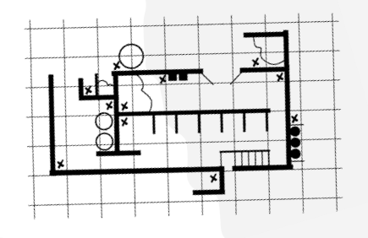
When can permanent baiting be done around buildings?
Key phrase: ‘high potential for reinvasion’
Neighbouring premises cannot be accessed
Neighbouring premises cannot be treated
The site itself may be very attractive to rodents
Cases where it is impossible to eradicate or present bait to the entire rodent population on-site or neighbouring site
When there is no alternative way to protect the people or premises
If proofing, improved housekeeping, trapping or other practical alternatives cannot be applied
© Copyright 2026
This presentation may be used free of charge in any format or medium provided that it is reproduced accurately and not used
in a misleading context. The material must be acknowledged as CRRU UK copyright and the title of the document specified.

Slide 25
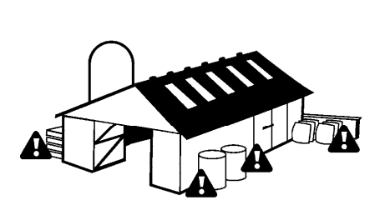
When can permanent baiting be done around buildings?
Visits:
Correct determination of level of infestation
Technician in charge decides frequency of visits following site survey
Product labels dictate – not more than 4 weeks between visits
© Copyright 2026
This presentation may be used free of charge in any format or medium provided that it is reproduced accurately and not used
in a misleading context. The material must be acknowledged as CRRU UK copyright and the title of the document specified.

Slide 26
Permanent baiting around buildings
Risk mitigation is paramount, site specific risk of reinvasion, human health / welfare, protected species risk must be assessed and documented
Environmental Risk Assessment (ERA) is imperative
Consider increased risk to non-targets if the target species is Norway rats due to:
Larger tamper-resistant bait stations being used
Potentially wider access of bystanders
Non-target access more likely
© Copyright 2026
This presentation may be used free of charge in any format or medium provided that it is reproduced accurately and not used
in a misleading context. The material must be acknowledged as CRRU UK copyright and the title of the document specified.

Slide 27
What is the alternative?
In simple terms, there isn’t one
While appropriately labelled cholecalciferol can be used for permanent baiting, with one option also for open areas, this active ingredient still poses certain risks
Appropriately labelled coumatetralyl (for permanent baiting in open areas) still poses risks
There is no direct replacement for rodenticides
This is one of the reasons that rodenticides can still be applied externally
Other alternatives are not economical or not as effective
Permanent baiting should still not be used as a routine business practice – consider all other methods of control first
© Copyright 2026
This presentation may be used free of charge in any format or medium provided that it is reproduced accurately and not used
in a misleading context. The material must be acknowledged as CRRU UK copyright and the title of the document specified.

Slide 28
Other measures
Proofing – prevention of access
Hygiene – restrict availability of food sources and harbourage
Frequent and thorough inspection – identify faster and treat earlier
Non-toxic monitoring – inspect regularly (site staff could assist) & can help determine species
Traps
© Copyright 2026
This presentation may be used free of charge in any format or medium provided that it is reproduced accurately and not used
in a misleading context. The material must be acknowledged as CRRU UK copyright and the title of the document specified.

Slide 29
Other measures
Programme extension:
Include neighbouring premises
Consider use of Local Authority to force compliance
Remote monitoring and sensing between visits to enhance observation
© Copyright 2026
This presentation may be used free of charge in any format or medium provided that it is reproduced accurately and not used
in a misleading context. The material must be acknowledged as CRRU UK copyright and the title of the document specified.

Slide 30
Label phrases
Prerequisites
Only coumatetralyl, bromadiolone, difenacoum and cholecalciferol products may have permanent baiting authorisation
Brodifacoum, difethialone and flocoumafen do not have permanent baiting authorisation
Each product label needs to be followed
Always read and follow the product label
© Copyright 2026
This presentation may be used free of charge in any format or medium provided that it is reproduced accurately and not used
in a misleading context. The material must be acknowledged as CRRU UK copyright and the title of the document specified.
Notes:
Note that not all products based on the active ingredients in bullet point 1 will have permanent baiting authorized on the label

Slide 31
Label phrases
The following label phrases appear on products that are authorised for permanent baiting
Permanent baiting is strictly limited to sites with a high potential for reinvasion when other methods of control have proven insufficient
The permanent baiting strategy shall be periodically reviewed in the context of integrated pest management (IPM) and the assessment of the risk for re-infestation
Sites under a permanent baiting regime should be inspected regularly in accordance with product labels
© Copyright 2026
This presentation may be used free of charge in any format or medium provided that it is reproduced accurately and not used
in a misleading context. The material must be acknowledged as CRRU UK copyright and the title of the document specified.

Slide 32
Label phrases
The following label phrases appear on products that are authorised for use in permanent baiting…continued…
Sites under a permanent baiting regime should be inspected regularly in accordance with product labels
The period between visits should be determined by the technician in charge but will not be longer than every four weeks when permanent baiting is conducted outdoors
For permanent baiting follow any additional instructions provided by the CRRU UK Guidance on Permanent Baiting
© Copyright 2026
This presentation may be used free of charge in any format or medium provided that it is reproduced accurately and not used
in a misleading context. The material must be acknowledged as CRRU UK copyright and the title of the document specified.

Slide 33
Label phrases – not for permanent baiting
These phrases appear on products that are not authorised for use in permanent baiting:
Do not use the product as permanent baits for the prevention of rodent infestation or monitoring of rodent activities
If after a treatment period of 35 days baits continue to be consumed and no decline in rodent activity is observed, the likely cause must be determined. Where other elements have been excluded, it is likely that there are resistant rodents so consider the use of a non-anticoagulant rodenticide, where available, or a more potent anticoagulant rodenticide
© Copyright 2026
This presentation may be used free of charge in any format or medium provided that it is reproduced accurately and not used
in a misleading context. The material must be acknowledged as CRRU UK copyright and the title of the document specified.

Slide 34
Label phrases – not for permanent baiting
These phrases appear on products that are not authorised for use in permanent baiting:
Also consider the use of traps as an alternative control measure
Products shall not be used beyond 35 days without an evaluation of the state of the infestation and of the efficacy of treatment
© Copyright 2026
This presentation may be used free of charge in any format or medium provided that it is reproduced accurately and not used
in a misleading context. The material must be acknowledged as CRRU UK copyright and the title of the document specified.

Slide 35

Long-term baiting
Rodenticides not authorised for permanent baiting may be used for long-term baiting (i.e. beyond 35 days) provided label requirements are met
There are a number of circumstances that may cause the need for baiting to be prolonged beyond 35 days. These include:
Very large and extensive infestation and the possible failure to recognise the size and extent of the infestation during the initial phase of the baiting programme
An initial reluctance of rodents to feed on baits, often cause by bait-shyness and/or refusal to enter bait boxes. This causes the effective start of the treatment to be delayed until the rodents begin to take baits.
Continuing immigration of rodents onto the treated site that cannot itself be treated
© Copyright 2026
This presentation may be used free of charge in any format or medium provided that it is reproduced accurately and not used
in a misleading context. The material must be acknowledged as CRRU UK copyright and the title of the document specified.

Slide 36

Resistance considerations
The circumstances at the site to be treated with respect to anticoagulant resistance
An infestation containing a proportion of resistant rodents may go unrecognised in the initial phase of the treatment
This will cause a prolonged treatment until the presence of resistance is either suspected or confirmed and appropriate alternative steps are taken.
Checks on permanent baits outdoors should be inspected at least once every 4 weeks
© Copyright 2026
This presentation may be used free of charge in any format or medium provided that it is reproduced accurately and not used
in a misleading context. The material must be acknowledged as CRRU UK copyright and the title of the document specified.

Slide 37


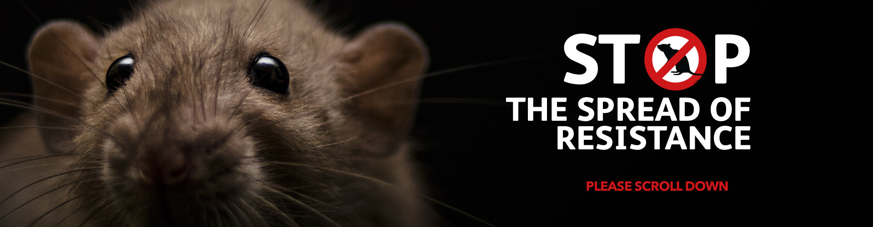
Resistance – resources
https://rrac.info
https://rrag.uk
www.thinkwildlife.org/anticoagulant-resistance-project
Resistance CPD presentation https://thinkwildlife.org/training-certification/continuing-professional-development-cpd-and-stewardship/
Check for any known resistance or suspected resistance in certain areas
Send tails for sampling
© Copyright 2026
This presentation may be used free of charge in any format or medium provided that it is reproduced accurately and not used
in a misleading context. The material must be acknowledged as CRRU UK copyright and the title of the document specified.

Slide 38
When to stop permanent baiting
If signs of takes by small mammals are found, usually clearly indicated by the size of droppings present in the bait stations, the poisoned bait should be removed.
Poisoned bait should also be removed from permanent bait points when a series of records show no takes of bait by rats. In such cases the reasons for conducting permanent rodenticide baiting should be reviewed.
A sequence of four to six checks at monthly intervals without takes by pest rodents would typically suggest that the immediate threat of rodent ingress had not been realised and the rodenticide baits should be removed.
Depending on circumstances, it may be that a shorter sequence of clear checks would justify removal of poisoned bait.
© Copyright 2026
This presentation may be used free of charge in any format or medium provided that it is reproduced accurately and not used
in a misleading context. The material must be acknowledged as CRRU UK copyright and the title of the document specified.

Slide 39
Final points
When using rodenticide, if non-target activity is detected – remove any rodenticide immediately and reconsider current course of action and review the Environmental Risk Assessment
Labels will state ‘to be used only by professional users holding certification demonstrating compliance with UK rodenticide stewardship regime requirements’
Permanent baiting should not be a routine practice
© Copyright 2026
This presentation may be used free of charge in any format or medium provided that it is reproduced accurately and not used
in a misleading context. The material must be acknowledged as CRRU UK copyright and the title of the document specified.

Slide 40
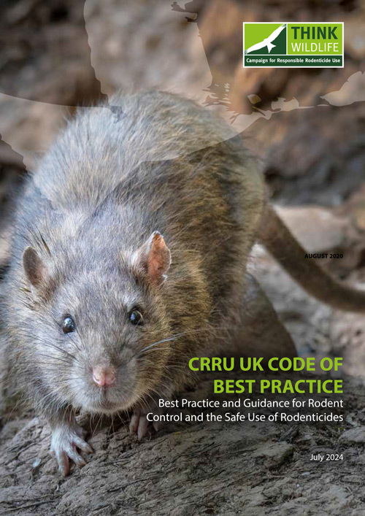
Final points continued…
Risks must be mitigated
An ongoing threat (of reinvasion and to health) to the premises, building or people must be present for permanent baiting to be justified. All other means of prevention, as appropriate, must be in place
Read product labels and accompanying information
Follow the CRRU UK Code of Best Practice
© Copyright 2026
This presentation may be used free of charge in any format or medium provided that it is reproduced accurately and not used
in a misleading context. The material must be acknowledged as CRRU UK copyright and the title of the document specified.

Slide 41
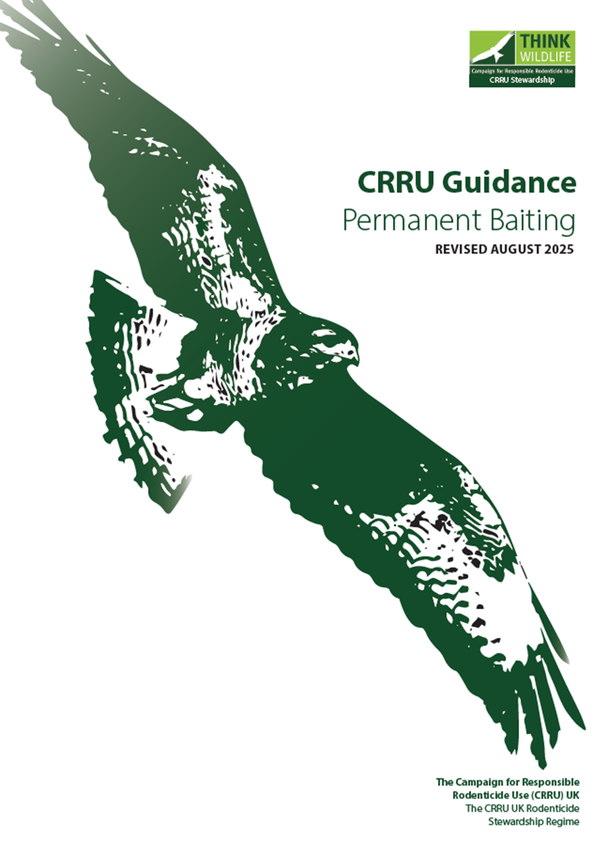
Thank you
© Copyright 2026
This presentation may be used free of charge in any format or medium provided that it is reproduced accurately and not used
in a misleading context. The material must be acknowledged as CRRU UK copyright and the title of the document specified.

