Slide 1
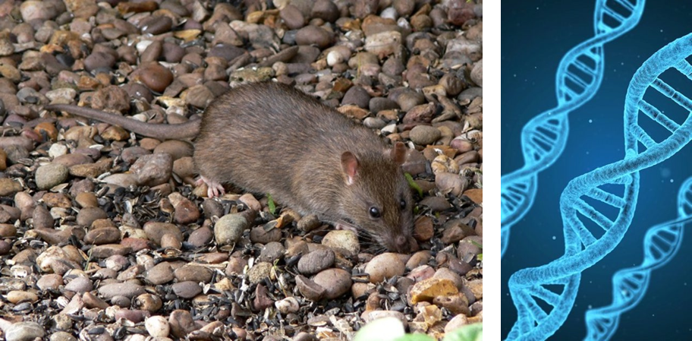
Resistance to anticoagulant
rodenticides in rats and mice
CRRU UK
A training resource for:
Continuing Professional Development
Dr Alan Buckle, University of Reading
© Copyright 2026
This presentation may be used free of charge in any format or medium provided that it is reproduced accurately and not used
in a misleading context. The material must be acknowledged as CRRU UK copyright and the title of the document specified.
Notes:
Updated with new resistance maps and data, by Dr Matthew Davies

Slide 2
Why take this CPD module?
When you have finished this module you will:
Understand how scientists identify anticoagulant resistance in the laboratory and in the field
Understand the genetic basis of anticoagulant resistance in rats and mice
Know the main different genetical resistance mutations, where they are to be found and how they differently affect the work of practical rodent pest management
Have an understanding of the recommendations of the UK Rodenticide Resistance Action Group about which anticoagulants to use in the presence of resistant rats and mice
NOTE: This module is NOT intended to provide detailed guidance on the control of resistant rodents, but instead to provide background information on the biology and distribution of anticoagulant resistance in the UK
© Copyright 2026
This presentation may be used free of charge in any format or medium provided that it is reproduced accurately and not used
in a misleading context. The material must be acknowledged as CRRU UK copyright and the title of the document specified.

Slide 3
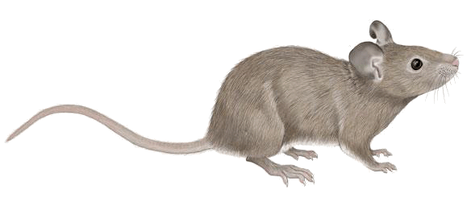
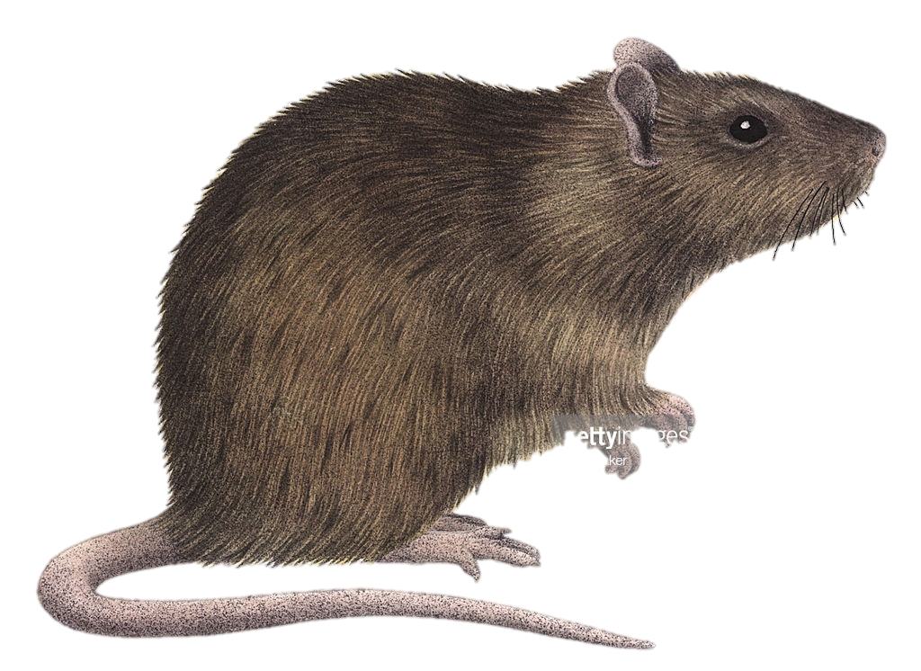
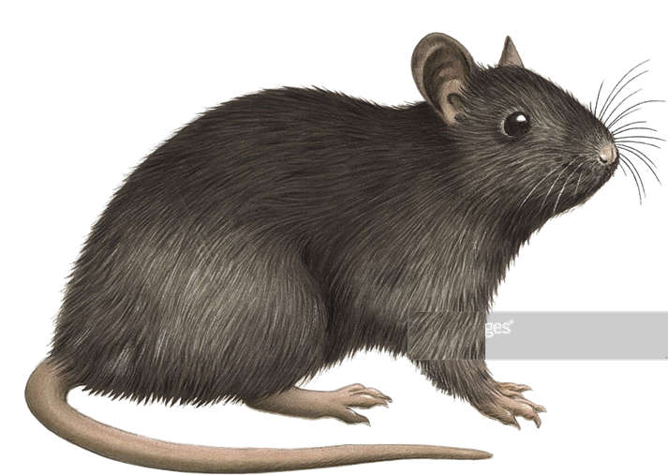
Rodent pests with resistance
House mice
Norway rats
Black rats
© Copyright 2026
This presentation may be used free of charge in any format or medium provided that it is reproduced accurately and not used
in a misleading context. The material must be acknowledged as CRRU UK copyright and the title of the document specified.
Notes:
Resistance to anticoagulants has been found in all three major commensal species, the house mouse, Norway rat and the black rat. We will not be talking about the black rat because its not particularly relevant to us in the UK and far less in known about its resistance. The house mouse and Norway or brown rat are by far the most dominant rodent pest in the UK and resistance to anticoagulants is very widespread in both species.

Slide 4
UK anticoagulant resistance – background information
© Copyright 2026
This presentation may be used free of charge in any format or medium provided that it is reproduced accurately and not used
in a misleading context. The material must be acknowledged as CRRU UK copyright and the title of the document specified.

Slide 5
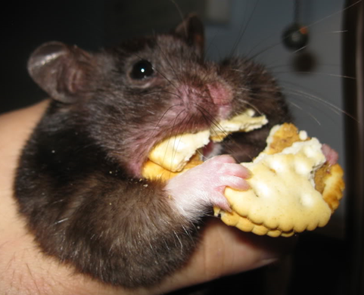
Anticoagulant rodenticides (ARs)
First-generation anticoagulants (FGARS) (e.g. warfarin, coumatetralyl) introduced in the 1950s. Resistance soon occurred
Second-generation anticoagulants (SGARs) developed and introduced in the 1970/80s to combat resistance
We now have resistance to some SGARs in rats and mice
Key advantage of all ARs – no bait shyness
© Copyright 2026
This presentation may be used free of charge in any format or medium provided that it is reproduced accurately and not used
in a misleading context. The material must be acknowledged as CRRU UK copyright and the title of the document specified.
Notes:
About 70 years ago anticoagulants came onto the market... Actually discovered in 1930s on a farm where many cattle were mysteriously dying from haemorrhages. It was because of a chemical contaminant in the hay that was preventing the cattle's blood from clotting. And from this contaminant, synthetic derivatives like warfarin were made.
The major advantage of anticoagulants is that they have a chronic mode of action so it can take several days or more to kill the animal, thus allowing the rodent to feed repeatedly on the bait before experiencing any symptoms.
So that’s why anticoagulants have been so successful and why they are still the dominate chemical control method used today.

Slide 6
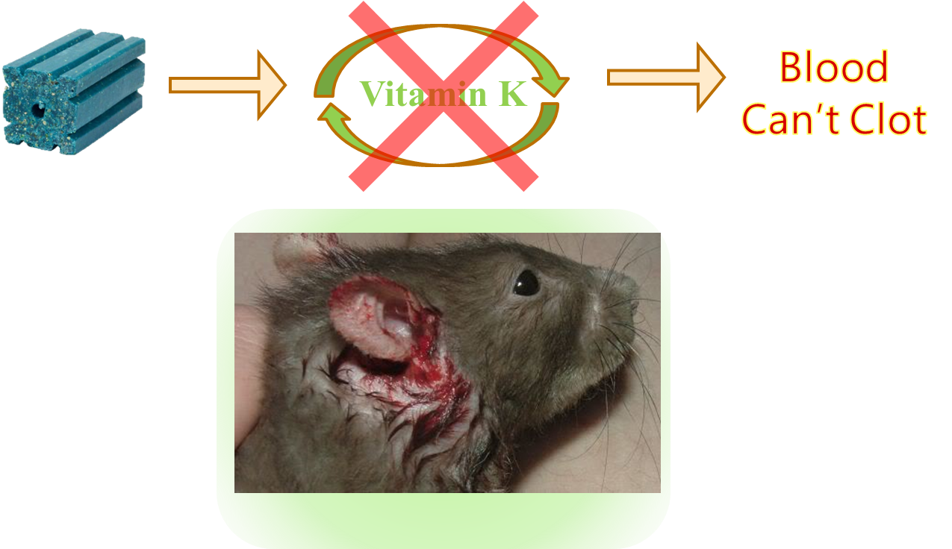
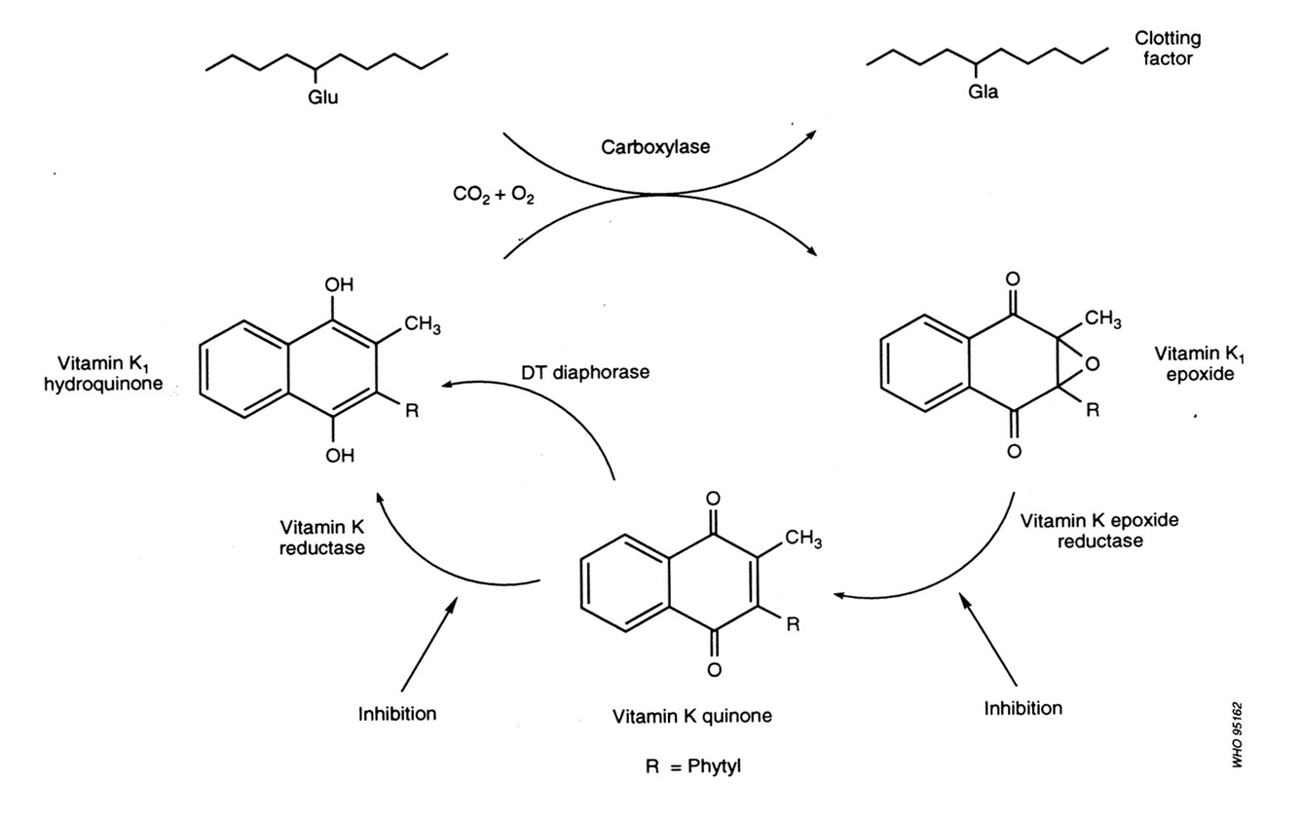
How do they work?
Anticoagulants block the vitamin K cycle
© Copyright 2026
This presentation may be used free of charge in any format or medium provided that it is reproduced accurately and not used
in a misleading context. The material must be acknowledged as CRRU UK copyright and the title of the document specified.
Notes:
All anticoagulants work in the same way by blocking the vitamin K cycle. The purpose of this cycle is to ensure a constant supply of activated vitamin K to permit blood clotting. It involves several enzymes and intermediate stages. When the cycle is blocked, activated vitamin K is no longer produced and blood fails to clot, leading to potentially fatal haemorrhages.
Anticoagulant molecules can outcompete vitamin k molecules by binding to a critical enzyme (vitamin K1 epoxide reductase). This stops the vitamin k cycle producing blood clotting factors.
This is why the antidote to anticoagulant poisoning is vitamin K1 and also why resistant animals tend to have a higher requirement for vitamin k in their diet.

Slide 7

Genetic resistance
Genetic studies show most resistance caused by a single gene mutation
  VKORC1 gene mutation
  Changes the shape of the enzyme
  Anticoagulant molecules cannot bind to block the vitamin K cycle
© Copyright 2026
This presentation may be used free of charge in any format or medium provided that it is reproduced accurately and not used
in a misleading context. The material must be acknowledged as CRRU UK copyright and the title of the document specified.
Notes:
It is known that a single gene is responsible for widespread resistance to anticoagulants (its called the VKORC1 gene) in both Norway rats and house mice..
Mutations within this gene, which can be passed onto the next generation, change the structure of the enzymes in the vitamin k cycle so that they block anticoagulant molecules from binding. In this way the vitamin k cycle can continue without interference and blood can clot as normal in resistant animals.
However, it is now known or suspected that some resistances, especially in house mice, may be either caused by or exacerbated by other metabolic processes. It is also known that Norway rats carrying L120Q the resistance strain known as “Berkshire-resistance” also have an additional metabolic capability to eliminate anticoagulants from their bodies both more quickly and more efficiently using cytochrome P450 enzymes. This confers on them the highest degree of resistance in Norway rats currently known.

Slide 8
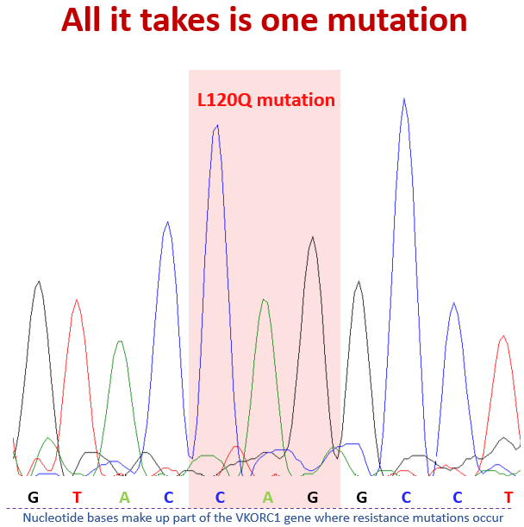
VKORC1 gene
This DNA sequence trace shows a genetic mutation in a rat
It only takes one nucleotide base to mutate/change
DNA nucleotide bases
L120Q resistance
© Copyright 2026
This presentation may be used free of charge in any format or medium provided that it is reproduced accurately and not used
in a misleading context. The material must be acknowledged as CRRU UK copyright and the title of the document specified.
Notes:
This shows a small section of a DNA sequencing trace. It shows that part of the genetic sequence responsible for Norway rat’s VKORC1 “resistance” gene. The letters at the bottom refer to nucleotide bases,
It only takes one of these bases to change (i.e. mutate) to result in a resistant animal! This individual has the L120Q resistance.
The four DNA nucleotide bases are:
G = guanine
T = thymine
A = adenine
C = cytosine
The genetic code in the resistant rat is CAG, whereas in a normal susceptible rat it would be CTG.
If the had the additional metabolic modification it will be “Berkshire resistant”. Without the modification it will be the less resistant “Hampshire resistant”. But the trace tells us nothing about this metabolic resistance.

Slide 9
Cross resistance
All anticoagulants act on the enzyme VKORC1 in the same way.
Although their abilities to block the enzyme (and hence the vitamin K cycle), and the time for which they block it, may vary
But this means that if an individual is resistant to one AR there will be some degree of resistance to others
But resistance severity won’t be exactly the same
Resistance SEVERITY
A
B
C
Anticoagulant
© Copyright 2026
This presentation may be used free of charge in any format or medium provided that it is reproduced accurately and not used
in a misleading context. The material must be acknowledged as CRRU UK copyright and the title of the document specified.
Notes:
Because anticoagulants act in the same way on the same enzyme, resistance to one compound also means there will be at least some resistance to other anticoagulant compounds. Therefore where warfarin resistance developed there is also cross resistance to other first generation anticoagulants (e.g. coumatetralyl)
However, the level of resistance will be different for each anticoagulant. There could be high resistance against one compound and low resistance against another or they could be very similar.

Slide 10
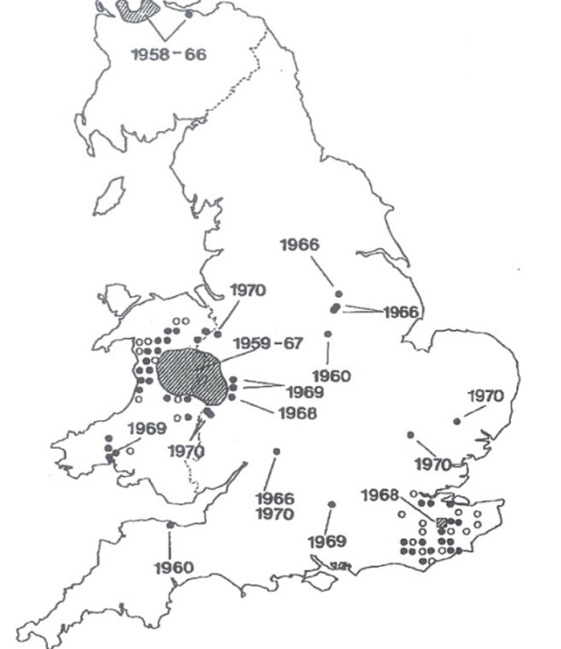
First UK resistance surveys – 1972 (outbreaks 1960s/1970s)
Anticoagulant resistance was first found in Norway rats in Scotland in1958
Government resistance surveys then found it in many other places around the UK
We now know that many of these foci had quite different resistance mutations (explained later)
© Copyright 2026
This presentation may be used free of charge in any format or medium provided that it is reproduced accurately and not used
in a misleading context. The material must be acknowledged as CRRU UK copyright and the title of the document specified.
Notes:
Resistance was first found in Norway rats in Scotland in the late 1950s.
Government resistance surveys quickly identified resistance in many other places. They did not know it then, but many of those early foci probably harboured rats carry different resistance mutations.
Of course, only FGARs were available at the time of these early surveys. The SGARs were developed during the mid-1970s to combat resistance.
We now also know that rats in many of the early resistance foci carried cross-resistance to bromadiolone and difenacoum even before they were invented!
The very fast emergence of the different resistances in UK Norway rats suggests that resistant mutations were already present in populations well before anticoagulants were introduced. They were in the populations at very low frequencies but the intensive use of the FGARs during the 1950s and 60s created strong selection for resistance and consequently quickly increased their prevalence.
We do not know why the UK has so many different resistance mutations in Norway rats – at least five that provide strong resistance, while some nearby countries have only one or two!

Slide 11
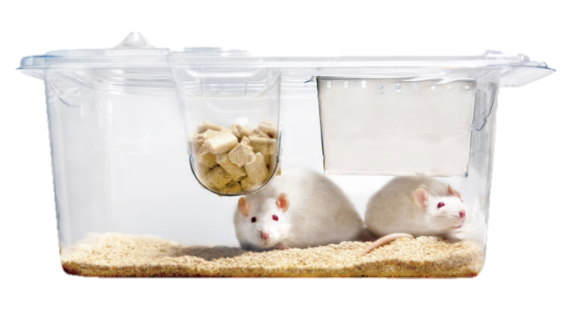

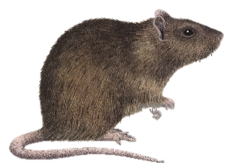
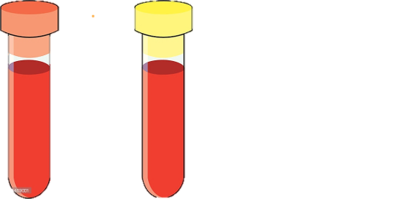

Identification of resistance
Lab Feeding Tests (1960s to 1980s)
    Advantage: Results indicate potential field performance
Limitation: Can’t determine specific mutation
Field Evaluations (1960s to date)
Advantage: Results demonstrate real field performance
Limitation: Can’t determine specific mutation
Lab Blood-Clotting Response Tests (1970s to date)
Advantage: Quick and easy to perform and can tell us relative strength of resistance
Limitation: Can’t determine specific mutation
DNA Sequencing (2005 to present)
Advantage: Tells us the exact mutation
Limitation: Can’t determine resistance severity
© Copyright 2026
This presentation may be used free of charge in any format or medium provided that it is reproduced accurately and not used
in a misleading context. The material must be acknowledged as CRRU UK copyright and the title of the document specified.
Notes:
When resistance first emerged there were only two ways to identify it. These were feeding tests with caged animals and field trials.
There are now 4 different ways of identifying resistance. But each technique alone can’t tell you the whole story, so in an ideal world all 4 techniques would be used to determine a population’s resistance status.
With Feeding tests and field trials, bait is presented to caged or wild rodents. If rodents eat large amounts of bait but survive they are likely to be resistant. Field trials are the ‘gold standard’ practical resistance test because they tell you true field performance of an AR.
A quicker and cheaper technique was developed however, the Blood-clotting response (BCR) test. In this animals are dosed in cages with an anticoagulant and the time taken for the blood to clot is measured. A resistant animal’s blood will clot quite quickly when given an AR dose that would stop the blood of a normal animal from clotting. The test is quantitative and if you measure clotting time you can tell which individuals carry resistance and the level of resistance they have. The longer it takes for that animals blood to clot the less resistant they are.
However, none of these tests tell you which type of resistance mutation is present.
DNA: The most recent method is DNA sequencing. This can identify if the animal has a resistant mutation and what mutation is it.
However, DNA tests alone can’t tell us the severity of the resistance to different compounds. We need the other tests for this.

Slide 12
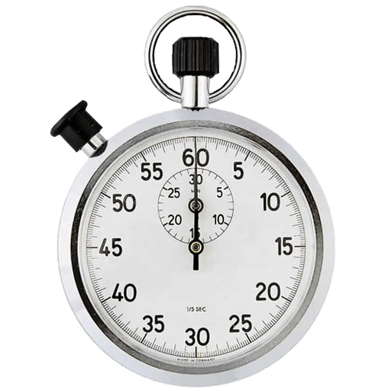
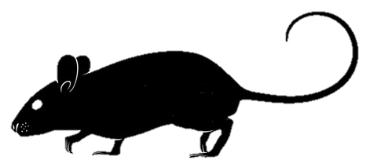

Blood clotting response (BCR)
Dose the animal
Take blood
Measure coagulation time
No anticoagulant administered
Coagulation time (usually measured in seconds)
Anticoagulant administered
Susceptible
Susceptible
Resistant
© Copyright 2026
This presentation may be used free of charge in any format or medium provided that it is reproduced accurately and not used
in a misleading context. The material must be acknowledged as CRRU UK copyright and the title of the document specified.
Notes:
The first bar shows the coagulation time for a normal susceptible animal that has not been dosed with an AR.
The other bars show the results of a test in which susceptible and resistant animals receive a usually effective dose of an AR. That is one that will normally cause the blood to clot. After a fixed period, blood is taken from the animals and the coagulation time of their blood is measured.
A resistant animal’s blood will clot quite quickly, in a similar time to that of a susceptible animal that has not been dosed. The dosed susceptible animal’s blood will take much longer to clot. So if you measure this clotting time you can tell which individuals carry resistance and, from how long clotting takes, what level of resistance they have. The longer the coagulation time the less resistant the animal.

Slide 13
Resistance severity
Trying to compare resistance levels is difficult
One way is to express relative degrees of resistance is using the term Resistance Factor (RF), sometimes called Resistance Ratio.
Resistance factor 2 = twice the normal dose needed to kill
Resistance factor 10 = ten times the normal dose needed to kill
Resistance factor 100 = one hundred times the normal dose needed to kill
© Copyright 2026
This presentation may be used free of charge in any format or medium provided that it is reproduced accurately and not used
in a misleading context. The material must be acknowledged as CRRU UK copyright and the title of the document specified.
Notes:
From blood clotting tests you can actually calculate what’s called a resistant ratio.
The ‘resistance ratio’ determines the amount of anticoagulant required to kill the target animal expressed as a multiple of the normal lethal dose
So if an animal had a resistant factor of 2 it would have to consume twice the amount of a normal lethal dose to result in death

Slide 14
Resistance definitions
TECHNICAL RESISTANCE
The resistance has no observable practical effect
e.g. resistance factors less than 5
PRACTICAL RESISTANCE
The resistance has a practical effect on control
e.g. resistance factors greater than 10
© Copyright 2026
This presentation may be used free of charge in any format or medium provided that it is reproduced accurately and not used
in a misleading context. The material must be acknowledged as CRRU UK copyright and the title of the document specified.
Notes:
Any animal that has a resistance factor greater than 1 might be said to be ‘resistant’ – at least to some degree.
We use two terms to describe if a finding of resistance is unlikely or likely to impact users of ARs in a significant way.
Technical resistance – is where resistance tests identify resistance but where resistance factors are so low that there is liable to be no observable practical effect on control treatments.
Practical resistance – is where resistance is identified and resistance factors are sufficiently high that an acceptable level of control is unlikely to be achieved in practical control treatments.
Rule of thumb:
Resistance factors less than 5 are unlikely to have a significant negative effect on practical treatment efficacy = technical resistance
Resistance factors greater than 10 are likely to have a significant detrimental effect on practical treatment efficacy = practical resistance

Slide 15

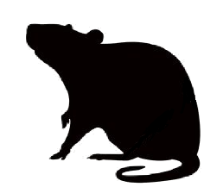

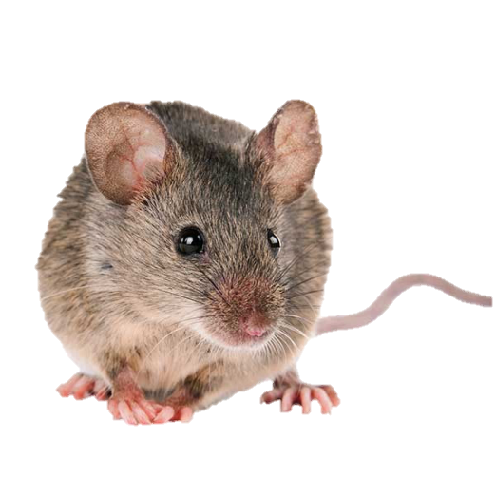


Resistance variations
(levels of resistance depend on several factors)
STRAIN
GENOTYPE
L120Q
SEX
NATURAL TOLERANCE
© Copyright 2026
This presentation may be used free of charge in any format or medium provided that it is reproduced accurately and not used
in a misleading context. The material must be acknowledged as CRRU UK copyright and the title of the document specified.
Notes:
Just to make things even more complicated, the level of resistance in individual rodents is affected by many factors such as
Strain
e.g. L120Q mutation has the highest recorded levels of resistance known
Genotype
Heterozygous rodents (that is those that carry only one copy of the resistance gene received from only one parent) have far lower resistance than homozygous rodents (that is those that carry two copies of the resistance gene, one received from each parent)
Sex
Females tend to have higher levels of resistance than males
Natural Tolerance (sometimes confusingly called natural resistance)
Natural tolerance to anticoagulants is known, particularly in mice

Slide 16
Homozygous & heterozygous resistance
Heterozygous & Homozygous
1 copy of the resistance mutation
1 copy of the wild type gene
Lower level of resistance
Can produce susceptible offspring
2 copies of the resistant mutation
Highest level of resistance
All offspring are resistant
© Copyright 2026
This presentation may be used free of charge in any format or medium provided that it is reproduced accurately and not used
in a misleading context. The material must be acknowledged as CRRU UK copyright and the title of the document specified.
Notes:
Genes exist in individual animals as two copies, one received from the mother and one from the father. These are called ALLELES.
An individual may receive identical alleles from each parent, that individual is said to be HOMOZYGOUS.
If an individual has received different alleles from each parent, that individual is said to be HETEROZYGOUS.
So, a fully susceptible animal has two copies of the normal i.e. susceptible allele.
Therefore resistance exists in two different forms:
- Heterozygous animals have one copy of the resistance allele and one normal (i.e. susceptible) allele.
- Homozygous animals have two copies of the resistance allele.
Resistance will be most severe in populations where homozygous individuals predominate. These animals have a much higher tolerance to anticoagulants (i.e. higher RFs) and always produce resistant offspring.
Importantly, DNA analysis not only tells us which resistance mutations are present but also if individuals are homo- or heterozygous.

Slide 17
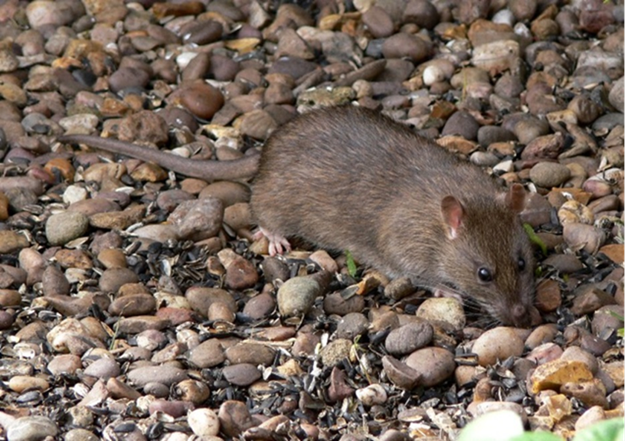
Anticoagulant resistance
Current status in Norway rats
© Copyright 2026
This presentation may be used free of charge in any format or medium provided that it is reproduced accurately and not used
in a misleading context. The material must be acknowledged as CRRU UK copyright and the title of the document specified.
Notes:
All maps used are the property CRRU UK and CRRU holds copyright. If they are reproduced this ownership should be clearly acknowledged.

Slide 18
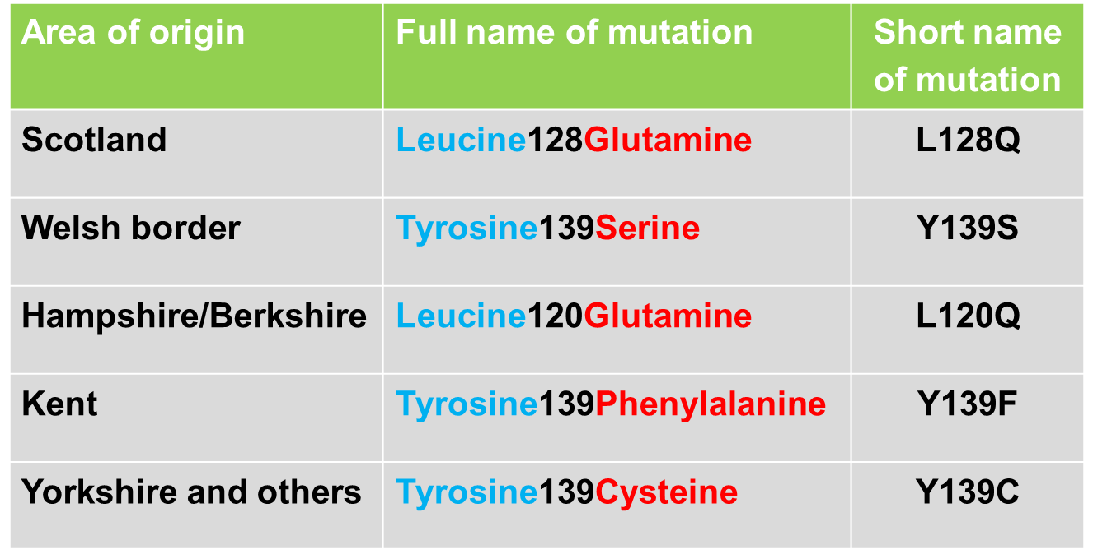
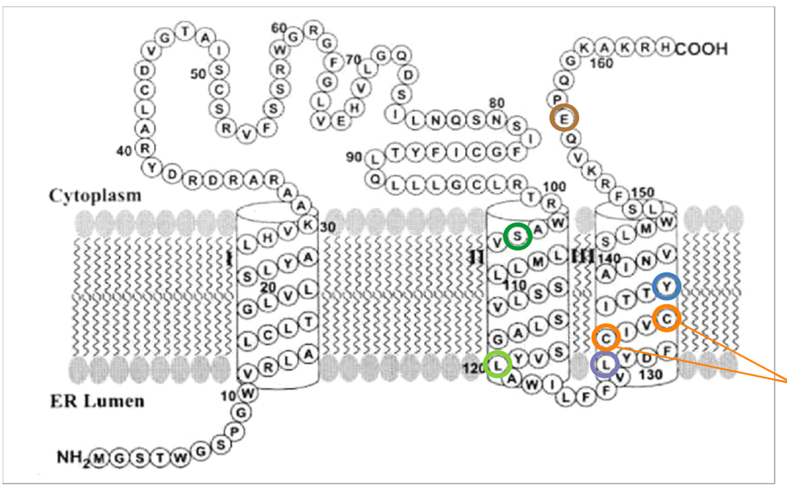
Five rat resistance mutations in UK
Wild-type amino acid Blue. Resistant amino acid Red
© Copyright 2026
This presentation may be used free of charge in any format or medium provided that it is reproduced accurately and not used
in a misleading context. The material must be acknowledged as CRRU UK copyright and the title of the document specified.
Notes:
There are five main Norway rat resistance mutations that we know have serious impacts on the efficacy of anticoagulant rodenticide in UK.
Each began at a specific geographical focus but has now spread more widely. Some more than others.
The VKORC1 molecule is like a string of beads, with each bead being a different amino-acid numbered from one end to the other on the chain.
The blue amino-acids in the table are those found in susceptible animals and the red are the mutated amino-acids found in resistant animals.
Show this figure to participants if you think they may be able to understand it.
The enzyme is positioned in the membrane of the endoplasmic reticulum in liver cells and passes through it three times. So it is said to be “membrane-bound”.

Slide 19
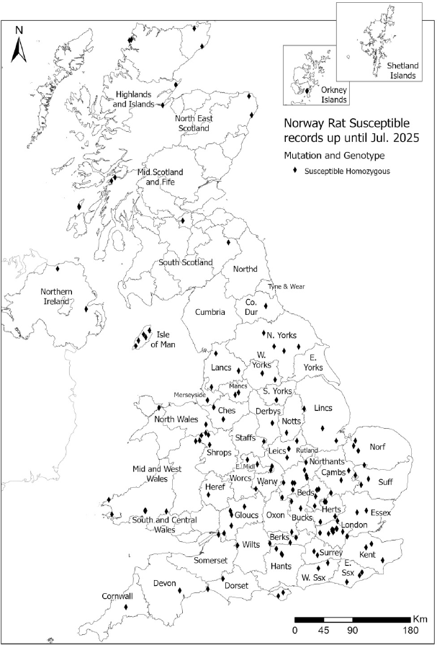
Susceptible Norway rats
Very widely dispersed
Some areas have lots of testing and little susceptibility found e.g. central southern England
Elsewhere, little testing so little susceptibility found
Susceptibility is not surprising because when two heterozygous resistant animals mate and breed 25% of offspring are fully susceptible
Knowing where susceptible animals are is only useful if we also know there is also no resistance
© Copyright 2026
This presentation may be used free of charge in any format or medium provided that it is reproduced accurately and not used
in a misleading context. The material must be acknowledged as CRRU UK copyright and the title of the document specified.

Slide 20
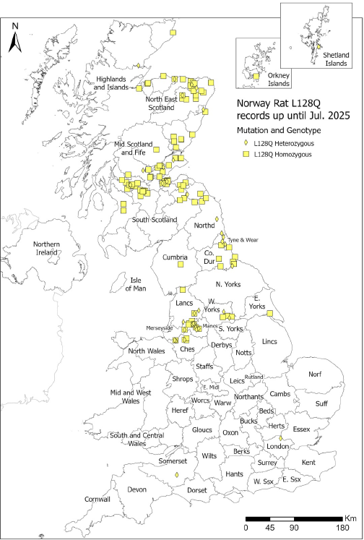
Norway rat L128Q resistance
First resistance ever found – Scotland 1958
Strong resistance to all FGARs
Full susceptibility to all SGARs
Limited spread so far: Central Belt of Scotland & now eastern Scotland, Greater Manchester, north-east coast of England
Not yet south of a line from the Humber to Mersey estuaries
Found in some rats with other mutations = HYBRID RESISTANCE
© Copyright 2026
This presentation may be used free of charge in any format or medium provided that it is reproduced accurately and not used
in a misleading context. The material must be acknowledged as CRRU UK copyright and the title of the document specified.
Notes:
Although not known at the time, this was the first resistance mutation ever found anywhere in the world. It is a relatively mild form of resistance. L128Q animals are strongly resistant to all FGARs. There is FGAR availability on the market, in the form of coumatetralyl. This should not be used in areas where it is known the L128Q-resistant rats are present.
However, L128Q rats are fully susceptible to all SGARs. Therefore, if SGARs are used effectively in L128Q areas there should be no reason why this mutation should spread any further.
However, because it is found over such a wide area, and other mutations are present in the same areas, we sometimes find rats that carry BOTH the L128Q mutation and another resistance gene. These are said to be HYBRID RESISTANT.

Slide 21
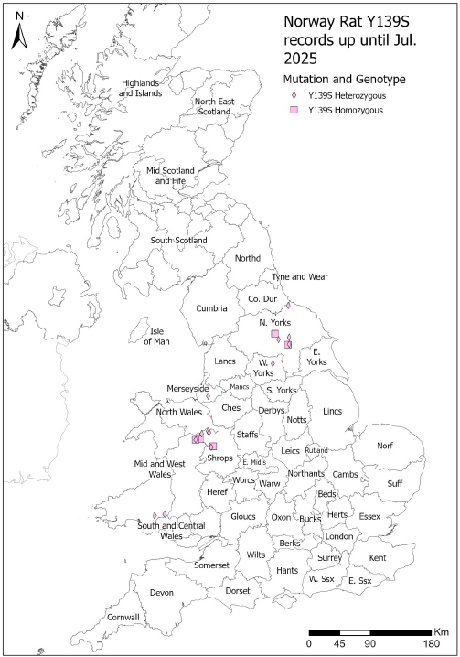
Norway rat Y139S resistance
Found in 1959 and once the largest known focus
With the exception of difethialone, all SGARs were first tested in the focus
Now very little testing here. So area is much underestimated. Probably still much of Wales and the East Midlands
Strong resistance to FGARs
Full susceptibility to potent SGARs (brodifacoum, difethialone, flocoumafen)
Somewhat lowered susceptibility to bromadiolone and difenacoum
Found nowhere else in the world for >50 years
Suddenly found in Yorkshire in 2019
© Copyright 2026
This presentation may be used free of charge in any format or medium provided that it is reproduced accurately and not used
in a misleading context. The material must be acknowledged as CRRU UK copyright and the title of the document specified.
Notes:
This resistance focus was much researched and consequently well-defined during the 1960s and 1970s. At that time it extended from the East Midlands to the Welsh coast and far south into central Wales (see earlier slide). However, because this focus is so well-known as the home of the original “super rats”, those who conduct pest control in these regions know about the resistance and very few DNA samples have been received.
For more than 50 years Y139S was known only from the Welsh focus. But in 2019 a single rat tail was received from North Yorkshire with this mutation. The map shows that Y139S rats have now spread more widely in the county and have reached the border with County Durham. It may not be a coincidence that the new focus first appeared close to a government laboratory where Y139S rats were held in captivity.
There is some evidence that Y139S rats may be rather less easy to control with bromadiolone and difenacoum than fully susceptible rats. However, these substances are still sufficiently effective and are recommended for use against rats carrying this mutation by RRAG (see below).

Slide 22
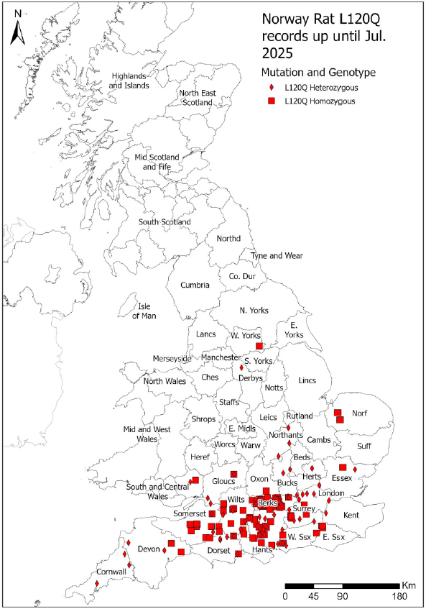
Norway rat L120Q resistance
Probably present since before 1969
Started on Hampshire/Berkshire border
Resistant to all FGARs and to bromadiolone and difenacoum
1982 government resistance field trials showed difenacoum and bromadiolone ineffective
Most severe mutation in the UK
Most rats tested homozygous resistant
Few fully susceptible rats found across central southern England!
Outlier foci increasing: East Anglia, far south-west, East Midlands, new sample from Devon
Found at one site in Scotland in hybrid with L128Q (not shown)
30-year government ban on potent SGARs outdoors certainly caused spread of this mutation
Some L120Q rats have enhanced metabolic resistance too
© Copyright 2026
This presentation may be used free of charge in any format or medium provided that it is reproduced accurately and not used
in a misleading context. The material must be acknowledged as CRRU UK copyright and the title of the document specified.
Notes:
First found in 1969 but probably around for many years before then. Early occurrence was on Hampshire/Berkshire border. When potent resistance-breakers brodifacoum and flocoumafen (and later difethialone) were introduced in the 1980s the government restricted their use to “indoors only” because of environmental concerns. This restriction meant that these effective substances could not be used for 30 years! Even though it was by then well-established by government research that difenacoum and bromadiolone were almost completely ineffective in this area. This forced users to break a fundamental rule of resistance management “do not use resisted substances against resistant rats”. The consequence of this policy was the massive spread of the most severe rat resistance mutation currently known across the whole of central southern England, and now much wider into East Anglia, the far south-west and to the counties of the East Midlands and elsewhere.
To make matters worse it now seems that the L120Q resistance exists as two different strains because in some areas rats are present with an enhanced ability to eliminate ARs from their bodies. Those without that ability are called “Hampshire-resistant” and those more resistant rats with the ability are called “Berkshire-resistant”. Presently we have now easy way of telling which strain is present without costly and time-consuming laboratory BCR studies – this is not being done in the UK since the closure of the University of Reading Vertebrate Pests Unit.
Among the SGARs, only the three most potent, brodifacoum, difethialone and flocoumafen should be used against L120Q rats.

Slide 23
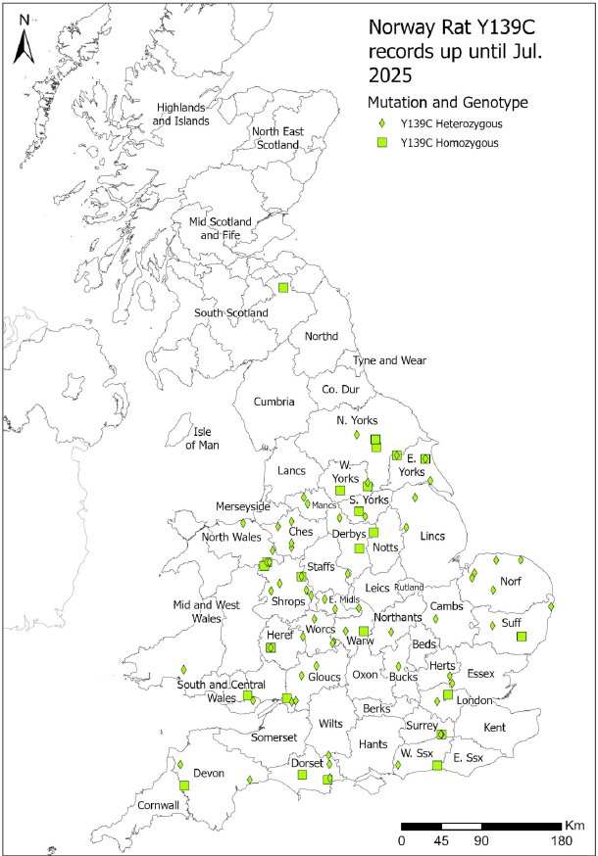
Norway rat Y139C resistance
Probably found in the 1972 at multiple sites
No known single original focus
By then Y139C was already present in Denmark and Germany
Very strange widespread distribution – multiple introductions?
Only most potent SGARs fully effective
Is now the most common mutation in UK resistance testing
Seven findings in Scotland in hybrid with L128Q (not shown)
Could be almost anywhere!
© Copyright 2026
This presentation may be used free of charge in any format or medium provided that it is reproduced accurately and not used
in a misleading context. The material must be acknowledged as CRRU UK copyright and the title of the document specified.

Slide 24
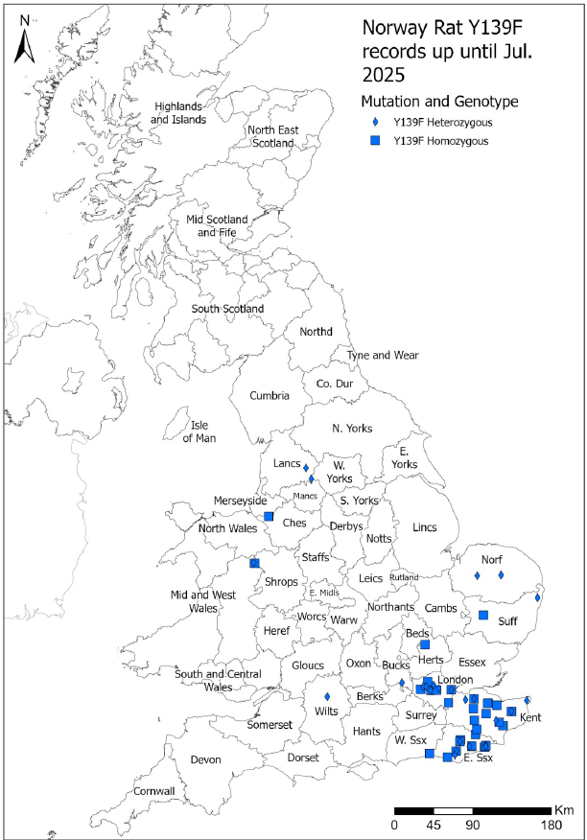
Norway rat Y139F resistance
Also found in early surveys – 1968
Nothing heard for 40 years until bromadiolone failure on a poultry farm in Kent
University of Reading project identified Y139F in UK for the first time in all 10 animals received – all homozygous
Now found throughout Kent and East Sussex and spread into East Anglia and north Wales
Most established resistance in Greater London
Most common mutation in rats in Belgium and northern France – did we get it from them or they from us?
Only potent SGARs fully effective
© Copyright 2026
This presentation may be used free of charge in any format or medium provided that it is reproduced accurately and not used
in a misleading context. The material must be acknowledged as CRRU UK copyright and the title of the document specified.
Notes:
Early surveys found a substantial resistance focus in rats in Kent and East Sussex. But this focus was not mentioned again after a survey conducted in 1977 in which resistance was found again there.
In 2009, the complete failure of bromadiolone treatments on a poultry farm at Cranbrook in Kent required further investigation. 10 animals were taken from the site and all proved to be homozygous resistant for Y139F. The high prevalence of resistance and homozygosity indicates a very long-established focus. More extensive subsequent DNA testing has shown a well-defined focus in Kent and East Sussex, with substantial occurrence across London. Y139F rats are now found in East Anglia with outlying foci many hundreds of miles away in the north-west.
Only the SGARs brodifacoum, difethialone and flocoumafen are recommended for use where Y139F rats occur.

Slide 25
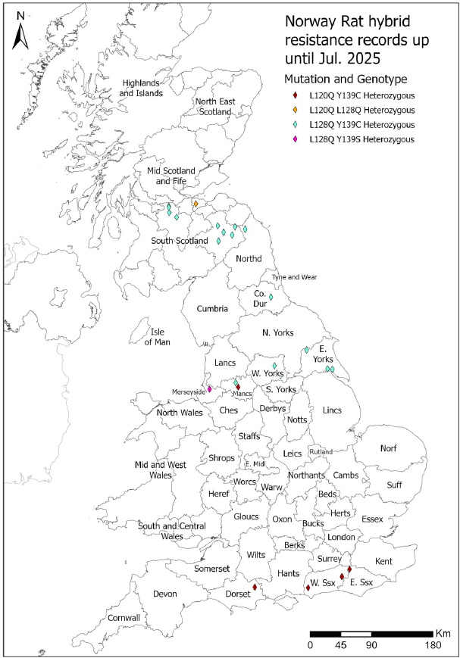
Norway rat ‘hybrid’ resistance
With the exception of Y139C, all other mutations started in well-defined single foci: Wales, Kent, Berkshire/Hampshire, Scotland
As foci spread, boundaries meet and resistant rats interbred, so animals with different mutations pass BOTH to offspring
In 2016 first rat with two resistance mutations – Scotland again!
In 2020, among only 54 sample, 8 more hybrid resistant
Four different combinations shown on the map
All resistance testing in UK was done on ‘pure’ strains
Impact on resistance management is uncertain
The L120Q/Y139C hybrid found in Manchester and on the south coast is likely to be the most resistant hybrid encountered
Seven L128Q/Y139C hybrid in south Scotland / Northumberland
© Copyright 2026
This presentation may be used free of charge in any format or medium provided that it is reproduced accurately and not used
in a misleading context. The material must be acknowledged as CRRU UK copyright and the title of the document specified.
Notes:
The Y139C probably had several original foci, most likely at least in Gloucestershire, Yorkshire and elsewhere. But the other four mutations, L120Q, L208Q, Y139C, Y139F, all began in relatively small and discrete single foci. But with poor resistance management, mainly because practitioners were denied the use of the most effective resistance-breaking substances for 30 years by government policy, these foci gradually spread.
It is then only to be expected that, eventually, rats carrying different resistance mutation will meet and interbreed. This results in the birth of animals carrying two different resistance mutations – HYBRID RESISTANT ANIMALS. For example, if a homozygous Y139C RAT mates with another that is homozygous for L128Q, all offspring will be heterozygous for BOTH mutations.
All we know from 50 years of work in the laboratory and field on anticoagulant resistance in the UK is gained from the study of animals carrying only one mutation. We simply do not know how hybrid resistant animals will respond to anticoagulant treatments. But there is preliminary evidence from work in France on house mice that they are more resistant than animals that are homozygous for a single mutation.

Slide 26
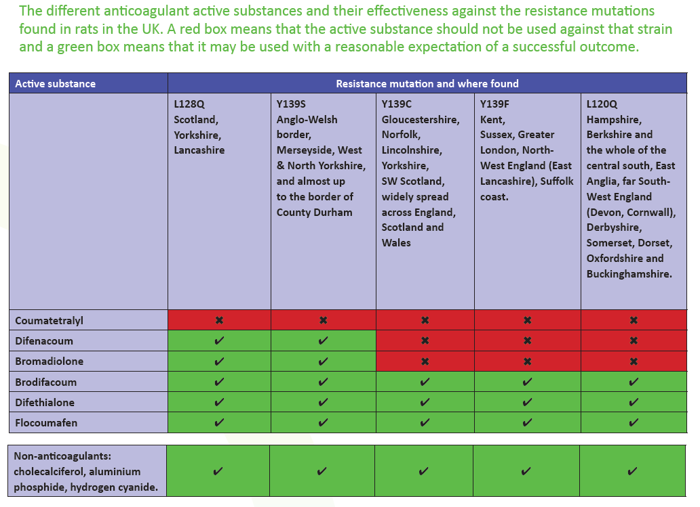
RRAG recommendations
© Copyright 2026
This presentation may be used free of charge in any format or medium provided that it is reproduced accurately and not used
in a misleading context. The material must be acknowledged as CRRU UK copyright and the title of the document specified.
Notes:
The UK Rodenticide Resistance Action Group (RRAG) is a panel of expert scientists, academics and experienced practitioners that meets to provide impartial advice.
The panel has examined all available information about the laboratory and field efficacy of the five SGARs against the five main UK rat resistance mutations.
The evidence is not entirely unequivocal and expert judgement was needed. However, where there was significant doubt it was felt best to err on the side of caution to ensure that effective substances are used. The worst possible outcome is for resisted substances to be used against rats that are resistant to them. This will increase resistant populations, leading to the spread of resistance and increasing its severity.

Slide 27
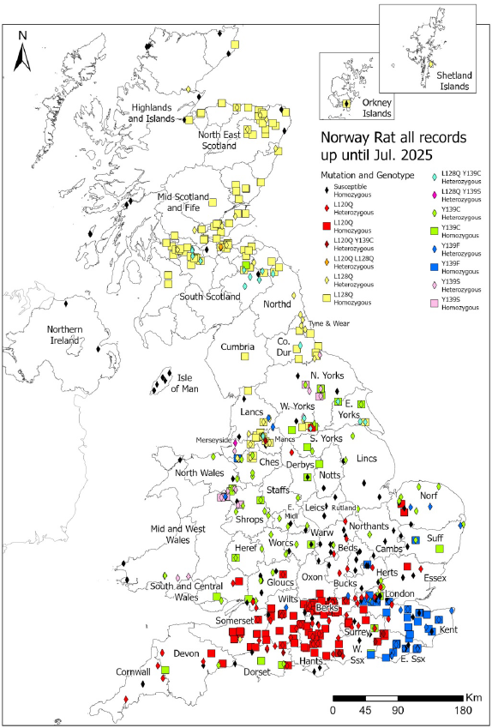
All rats DNA resistance testing – to July 2025
Total of 753 tail samples – 75.1% resistant
Colours symbols show resistance incidence from all rat tail tip testing done to date
Black symbols show susceptibles
Slide is shown to provide and overall picture of UK rat resistance distribution
Blank areas do not mean ‘no resistance’, but no testing
© Copyright 2026
This presentation may be used free of charge in any format or medium provided that it is reproduced accurately and not used
in a misleading context. The material must be acknowledged as CRRU UK copyright and the title of the document specified.
Notes:
The text on the slide needs little further explanation.
The data provided is the result of work on 753 tail tip samples that yielded viable DNA material, as well as many that failed.
The general advice given is in accordance with the recommendations of the RRAG and the CRRU Code of Best Practice.
The overriding guidance is that substances should not be used where there is strong evidence that rats that are resistant to them are present.

Slide 28
All rats DNA resistance testing – to July 2025
South of an imaginary line from Thames to Severn estuaries, very high incidence of very severe L120Q and Y139F mutations. Bromadiolone and difenacoum are not recommended
North of a line joining the Humber and Mersey estuaries, fewer incidences of severe resistance means that all five SGARs may be used. But ‘risk hierarchy’ says bromadiolone and difenacoum should be considered first
Between those two lines there is considerable incidence of susceptibles, although the severe Y139C is quickly gaining ground. Here it is advisable to make site by site resistance assessments
© Copyright 2026
This presentation may be used free of charge in any format or medium provided that it is reproduced accurately and not used
in a misleading context. The material must be acknowledged as CRRU UK copyright and the title of the document specified.
Notes:
The text on the slide needs little further explanation.
The data provided is the result of work on 753 tail tip samples that yielded viable DNA material, as well as many that failed.
The general advice given is in accordance with the recommendations of the RRAG and the CRRU Code of Best Practice.
The overriding guidance is that substances should not be used where there is strong evidence that rats that are resistant to them are present.

Slide 29
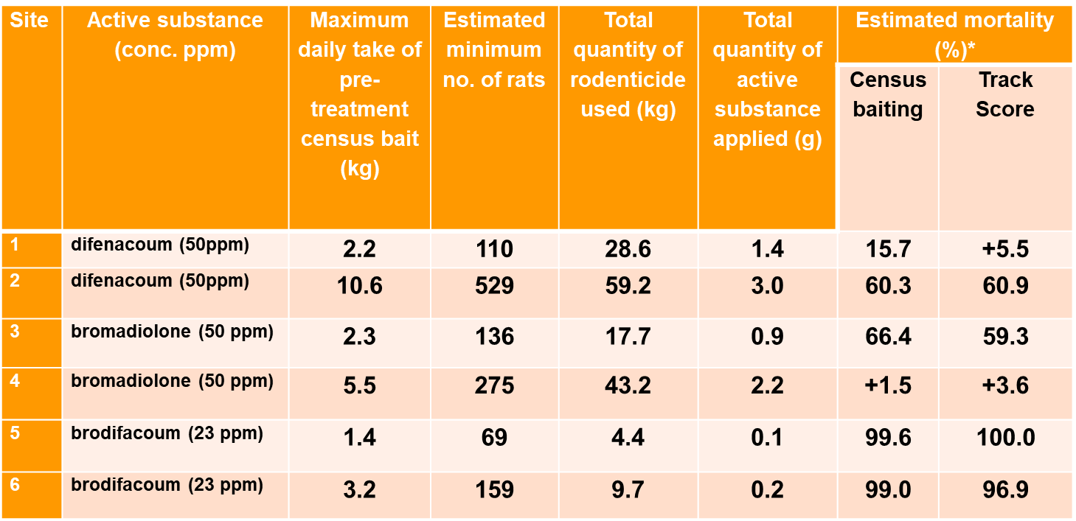
Effects of L120Q resistance on Norway rat control in field trials by University of Reading
First 111 rats were tested on the six farms - 99.1% L120Q resistant, 86.9% homozygous
  Source: Buckle et al., (2020). Crop Protection. Vol. 137, 11 pages.
© Copyright 2026
This presentation may be used free of charge in any format or medium provided that it is reproduced accurately and not used
in a misleading context. The material must be acknowledged as CRRU UK copyright and the title of the document specified.
Notes:
These field trials show the impacts of the L120Q rat resistance mutation on the efficacy of bromadiolone and difenacoum. They also show that the 30-year government policy to deny practitioners the use of brodifacoum in the Hampshire/Berkshire area was both misguided and counter productive.
The first four trials could be done under the existing regulations in 2008 but it was then impossible to test brodifacoum outdoors and an application for a permit to test brodifacoum was refused. Those trials could not be done until regulations changed in 2016 and brodifacoum could finally be used in and around buildings.
The infestations used were all relatively large. Virtually all the rats present on the four farms were resistant, most of them homozygous. Two bromadiolone (50 ppm) and two difenacoum (50 ppm) treatments were either partially of wholly ineffective. The differences may have been because of the presence of some hyper-resistant rats carrying BOTH the L120Q mutation and having an enhanced poison-clearing mechanism. This sort of result had been going on for 30 years and led to the rapid expansion of this focus and to increased resistance severity.
Now look at the two 23 ppm brodifacoum treatments. Both were entirely effective. Note the large differences in the quantities of the active substances released into the environment. The big difference is that any brodifacoum residues in rats at the end of the treatments were in DEAD rats – which soon decayed. The much larger residues of bromadiolone and difenacoum were mostly in LIVE rats that then carried them for the rest of their lives to enter terrestrial food chains when consumed by predators and scavenger. This shows that the government policy was not only misguided because of its resulting effects on resistance development and spread, but also in that it was counter productive in its main purpose to protect the environment!

Slide 30




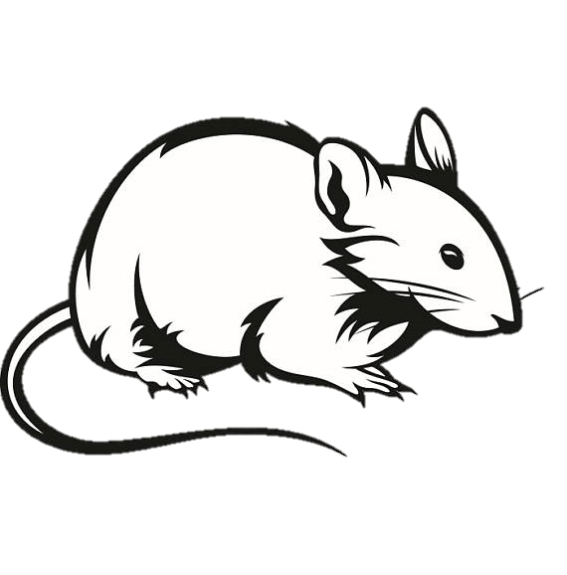
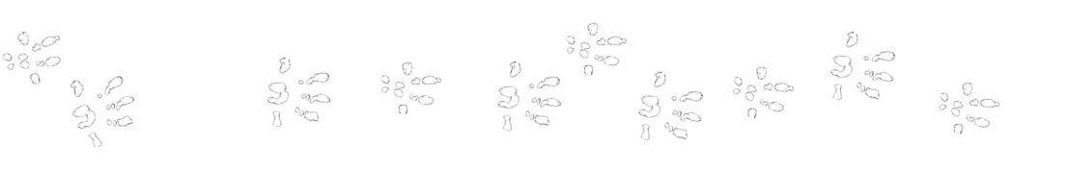
House mouse VKORC1 mutations
L128S – First discovered Cambridge 1960s
Y139C – First discovered Reading 1970s
Y139C/L128S Hybrid – First found London 2017
Spretus introgression – First (and only)
found in Hertfordshire 2022
© Copyright 2026
This presentation may be used free of charge in any format or medium provided that it is reproduced accurately and not used
in a misleading context. The material must be acknowledged as CRRU UK copyright and the title of the document specified.
Notes:
For the house mouse, there three known resistant mutations in the UK – Y139C, L128S and the so-called ‘spretus introgression’.
Resistant in house mice had been recorded for more than 60 years and was first found in Cambridge. We now know that this was due to the presence of the L128S mutation. All the early work on the efficacy of SGARs against resistance mice used laboratory strains of this mutation.
Later, a second mutation was discovered from an area outside Reading and this was found to be the result of a second mutation, Y139C. It is worth noting that this mutation occurs also in Norway rats.
A third mutation, the so-called ‘spretus introgression’, had been long known from mice on the continent. It appeared for the first time in UK in a sample of mouse tails taken during treatment that had failed at a large bulk grain transit depot in Hertfordshire in 2022. Several of the spretus mice also carried the L128S mutation and so this was another example of hybrid resistance.

Slide 31
House mouse resistance
Much less known about resistance in mice than Norway rats
Mice are intrinsically less susceptible to all ARs – NATURAL RESISTANCE
All known mouse resistance confers very strong resistance to FGARs and to the less potent SGARs bromadiolone and difenacoum
We have 144 mouse tail samples and 94.4% are resistant
Increasing occurrence of hybrid resistance - hybrid mice are highly resistant
RRAG advice:
  All mouse control treatments should be based on an assumption that resistance is present
  Among ARs only brodifacoum, difethialone and flocoumfen should be used against house mice
  Only use ‘high-strength’ (i.e. 50 ppm) SGAR baits against mice
© Copyright 2026
This presentation may be used free of charge in any format or medium provided that it is reproduced accurately and not used
in a misleading context. The material must be acknowledged as CRRU UK copyright and the title of the document specified.

Slide 32
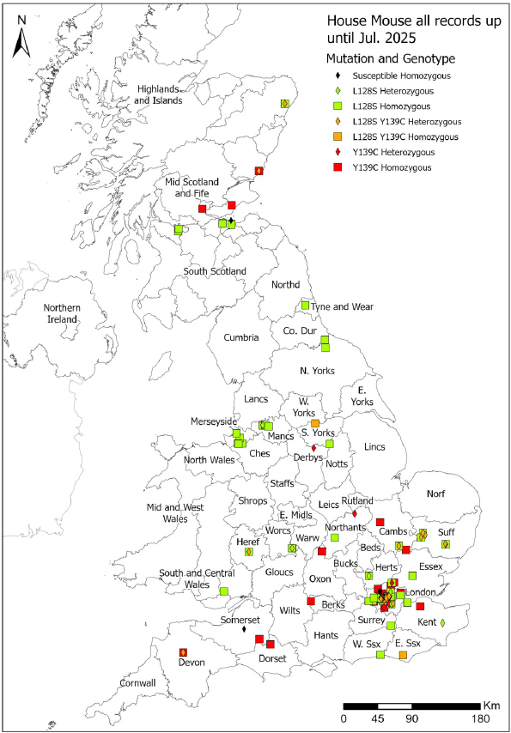
House mouse resistance
94.4% of 144 house mouse samples resistant
Very high percentage of homozygous animals – resistance very long established i.e. both parents homozygous resistant all offspring will be resistant!
Until Y139C was found on SE Scotland recently, it was mainly in southern England
‘Spretus’ focus in Hertfordshire ‘hidden’ as L128S overlays it
Hybrid resistance is very widespread – 2 x L128S/Y139C from Aberdeenshire
Fewer mouse samples maybe as RRAG says assume all house mice are resistant – so why submit samples?
© Copyright 2026
This presentation may be used free of charge in any format or medium provided that it is reproduced accurately and not used
in a misleading context. The material must be acknowledged as CRRU UK copyright and the title of the document specified.
Notes:
Again we have produced a map of Britain showing where we have found these mutations
We have a much lower number of samples compared to Norway rats
But we’ve had a good number from London where 88% of the mice we sampled had at least one resistance mutation
And over half of these were homozygous which suggests that ineffective poisons have been favouring resistant mice over many generations

Slide 33
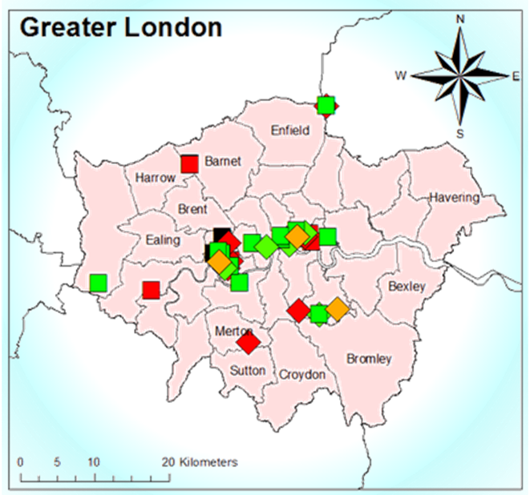
Is London a resistance ‘hotspot’?
Probably not! We suspect most big cities will be like this
But the Greater London Pest Liaison Group has run organised surveys – so we know more about mouse resistance in London
What is certain is that ‘hybrid resistance’ is present – this will lead to more problems when using ARs
© Copyright 2026
This presentation may be used free of charge in any format or medium provided that it is reproduced accurately and not used
in a misleading context. The material must be acknowledged as CRRU UK copyright and the title of the document specified.
Notes:
The Greater London Pest Liaison Group (GLPLG) has worked systematically to send rodent tail samples first to Reading University and later into the CRRU testing system. So we know more about resistance in London than on other similar cities. But we expect they situation with respect to AR resistant will be similar elsewhere.

Slide 34
RRAG Recommendations
Not recommended
Recommended
Active Substance | Resistance Mutation
 | L128S | Y139C
Coumatetralyl
Bromadiolone
Difenacoum
Brodifacoum
Difethialone
Flocoumafen
FGARs
SGARs
© Copyright 2026
This presentation may be used free of charge in any format or medium provided that it is reproduced accurately and not used
in a misleading context. The material must be acknowledged as CRRU UK copyright and the title of the document specified.
Notes:
The slide summarises the RRAG advice about the use of ARs against all UK house mice.

Slide 35
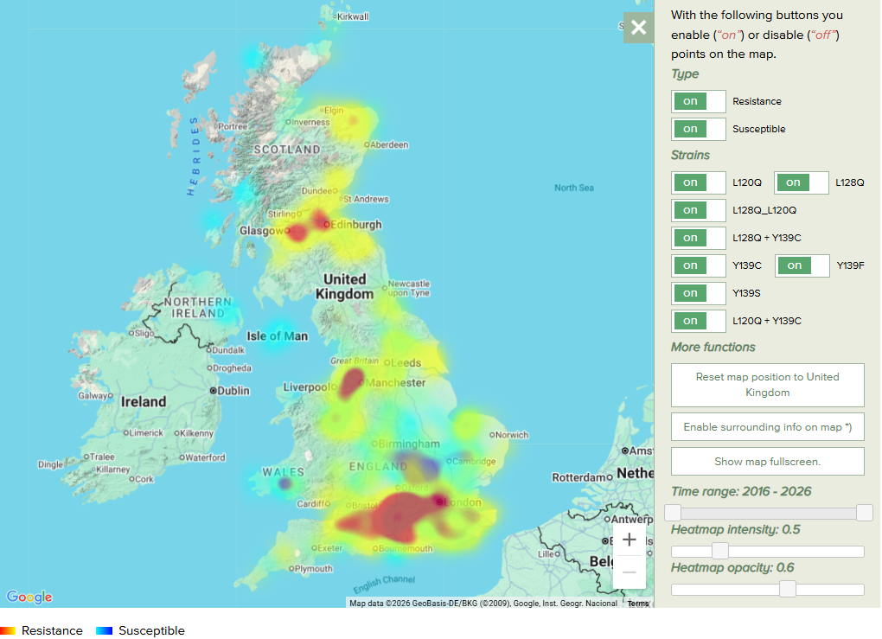
RRAC Resistance maps (Norway rat shown)
All CRRU UK data sent to RRAC
Interactive maps available from the RRAC website: http://guide.rrac.info/resistance-maps
Maps for both rats and mice available
Now available as an App for Android devices
© Copyright 2026
This presentation may be used free of charge in any format or medium provided that it is reproduced accurately and not used
in a misleading context. The material must be acknowledged as CRRU UK copyright and the title of the document specified.
Notes:
There are interactive maps and questionnaires on the RRAC website which are designed to tell you which areas are known to have a resistance problem and what anticoagulants to avoid using. You can also download a version of the maps in an App available for mobile phones.
This RRAC map shows UK data for Norway rats. The panel to the right allows you to select different data to be displayed. In this example all available the Norway rat data are shown, i.e. the five resistance mutations and susceptible animals.

Slide 36
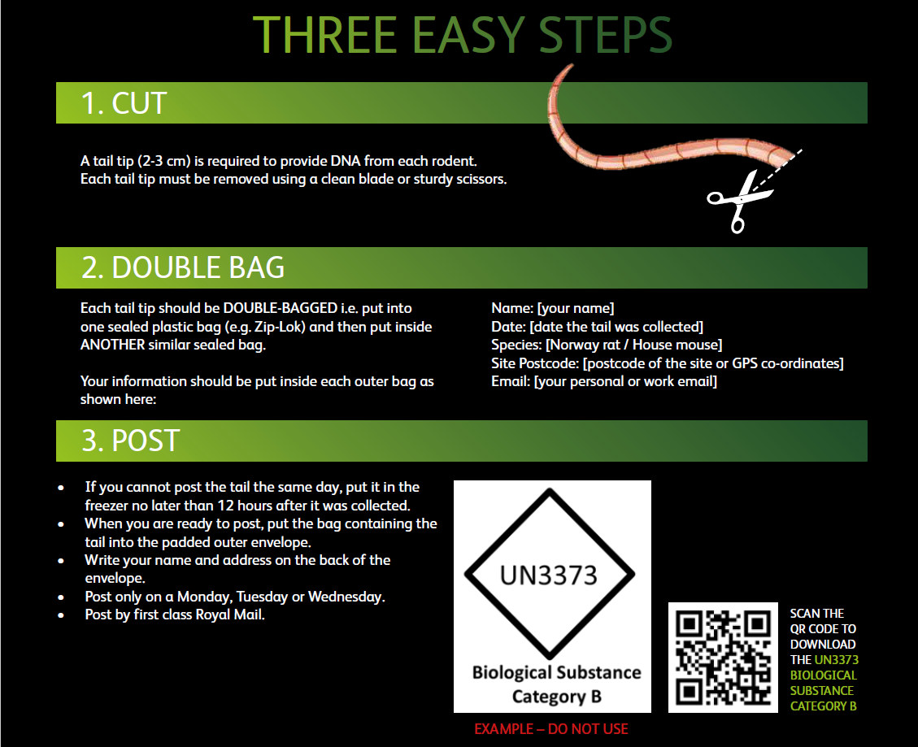
DNA resistance testing is free – use it!
Free resistance screening of rat and mouse tail-tip samples
‘How to’ advice and free sampling kits from the CRRU UK website:
https://www.thinkwildlife.org/anticoagulant-resistance-project/
© Copyright 2026
This presentation may be used free of charge in any format or medium provided that it is reproduced accurately and not used
in a misleading context. The material must be acknowledged as CRRU UK copyright and the title of the document specified.
Notes:
DNA tail tip testing of rats and mice is now available free to all who use professional rodenticides in a CRRU UK-funded project. Advice on how to take the tissue samples and send them securely to the testing laboratory at Science and Advice for Scottish Agriculture (SASA) in Edinburgh is available at the CRRU UK website. But be warned, the project is designed only to provide accurate geographical data on resistance. It is not a fast-acting diagnostic process because the batch testing methodology used at the laboratory mean that the results may take several months to come back. When they do come back you will receive a sheet to tell you what the results are and the best methods for managing your resistant rodents if you have them.

Slide 37
Summary and recommendations
Five rat resistance mutations present in UK, three so severe that the use of bromadiolone and difenacoum against rats carrying them is not recommended
Rat resistance mutations present in Wales, northern England and some areas of Scotland are not so severe. Bromadiolone and difenacoum remain effective
However, the severe Y139C (bromadiolone & difenacoum not effective) is increasingly found in Scotland & Scottish borders rats, along with further hybrid resistance
Severe resistance is so prevalent in UK house mice that, among ARs, only brodifacoum, difethialone and flocoumafen are recommended against them
Check current knowledge about resistance in YOUR area by looking at the interactive RRAC resistance maps http://guide.rrac.info/resistance-maps
Send rat & mouse tail tips to the CRRU UK DNA resistance testing lab at SASA in Scotland
© Copyright 2026
This presentation may be used free of charge in any format or medium provided that it is reproduced accurately and not used
in a misleading context. The material must be acknowledged as CRRU UK copyright and the title of the document specified.
Notes:
Slide requires no further clarification.

Slide 38
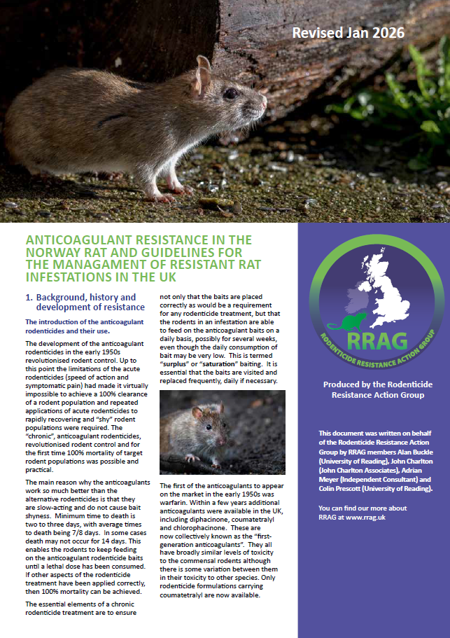
Summary and recommendations
GOLDEN RULE for resistance management: do not use resisted substances against rodents that are resistant to them
Follow RRAG guidance in the management of resistant rodent infestations
Remember : the advantage of alternatives to ARs against resistant rodents is – NO SELECTION FOR RESISTANCE
Always adopt an integrated pest management (IPM) approach
© Copyright 2026
This presentation may be used free of charge in any format or medium provided that it is reproduced accurately and not used
in a misleading context. The material must be acknowledged as CRRU UK copyright and the title of the document specified.
Notes:
Slide requires no further clarification.

Slide 39
Further Reading
Anticoagulant resistance in the Norway rat and guidelines for the management of resistant rat infestations in the UK. https://www.rrag.uk/rrag-pubs
Anticoagulant resistance in the House mouse and guidelines for the management of resistant mouse infestations in the UK. https://www.rrag.uk/rrag-pubs
Anticoagulant Resistance in Rats and Mice in the UK – new data for August 2024 to July 2025. Buckle et al. (2025). University of Reading. Report Number VPU/25/001. https://www.thinkwildlife.org/downloads/
CRRU UK Code of Best Practice. Best Practice and Guidance for Rodent Control and the Safe Use of Rodenticides. July 2024. https://www.thinkwildlife.org/downloads/
© Copyright 2026
This presentation may be used free of charge in any format or medium provided that it is reproduced accurately and not used
in a misleading context. The material must be acknowledged as CRRU UK copyright and the title of the document specified.

Slide 40
Thank you
© Copyright 2026
This presentation may be used free of charge in any format or medium provided that it is reproduced accurately and not used
in a misleading context. The material must be acknowledged as CRRU UK copyright and the title of the document specified.

